Slide 1
The Evolving Role of AI in Insurance
A look into the Past, Present, and Future of Technology in the industry
Michael Kelch
Sam Heil
Adam Ramos
3/28/19
Notes:
Everyone give at least a one sentence description. (i.e. student, analyst in Bloomington office, analyst in Atlanta office)

Slide 2
Outline
Past
  The First Actuary
  Definitions
Present
  Current Technology
  Trends
Future
  Impacts
  How to prepare
  Regulations

Slide 3
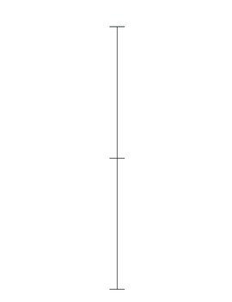
The First Actuary
14th century
One of first known insurance contracts
First life table created
Early 17th century
1762
First life premiums calculated “scientifically”
Models introduced and computers begin to revolutionize the industry
Mid 20th century
Actuaries in practice use a variety of tables, models, and theory. All made more efficient with growing technology
Current day
Notes:
”The earliest records of an official non-life insurance policy come from Sicily, where there is record of a 14th-century contract to insure a shipment of wheat (Sweeting 2011, p. 14). In 1350, Lenardo Cattaneo assumed "all risks from act of God, or of man, and from perils of the sea" that may occur to a shipment of wheat from Sicily to Tunis up to a maximum of 300 florins. For this he was paid a premium of 18% (Lewin 2007, p. 4).”
“The first person to correctly calculate these values was Edmond Halley (Heywood 1985).”
“1920 revision to workers' compensation rates took over two months of around-the-clock work by day and night teams of actuaries”
“pencil-and-paper to punchcards to microcomputers, the modeling and forecasting ability of the actuary has grown exponentially”

Slide 4
Data Science vs Actuarial Science
Both professions use data to make informed decisions about the future.
Actuaries are essentially data scientists with extensive insurance knowledge.
With the growing usage of many programming languages, it is essential for the actuarial profession to broaden its skillset.
  Examples of growing languages include: R, Python, C++, SAS, among many others

Slide 5
Artificial Intelligence vs Machine Learning
Artificial Intelligence
Machine Learning
The science of training machines to perform tasks.
Any program that seeks to imitate human intelligence.
Can range from as simple as if-then statements to a complex statistical software.
Machine Learning is a subset of AI that trains a machine how to learn.
Looks for patterns in data and draws conclusions.
Uses a cycle of analyzing data to refine algorithms

Slide 6
AI Insurance Companies
Brolly
Lemonade
Spixii.ai
Notes:
I will talk about the companies already moving towards the example I gave previously.

Slide 7
How many jobs are at risk (in US)?
Claims adjusters – 125,000
Insurance agents – 1.1 million
Underwriters
Notes:
I will talk about the jobs at risk in the U.S. and how the insurance industry may change as it pertains to employment.

Slide 8
AI and other Technology Present in Insurance Today
Liberty Mutual immediate response claim cost estimates
OnStar Automatic Crash Response
Allstate’s “ABIe”
State Farm’s Distracted Driver Competition
Progressive’s Snapshot
  14 billion miles of driving data
Wearables (Apple, Fitbit, Xiaomi)
DriveCam by Lytx
Existing tech affecting insurance every day
  Computing Power and Big Data
  Phone and Surveillance Cameras
  Social media

Slide 9
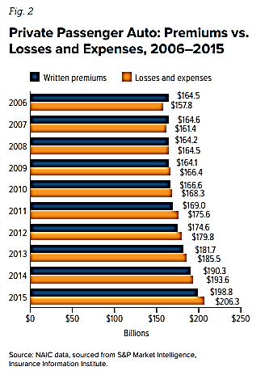
Trends – Deteriorating Loss Ratios
https://www.iii.org/sites/default/files/docs/pdf/auto_rates_wp_092716-62.pdf
Notes:
Explain chart and what is being shown. Axis, chart key, data example

Slide 10
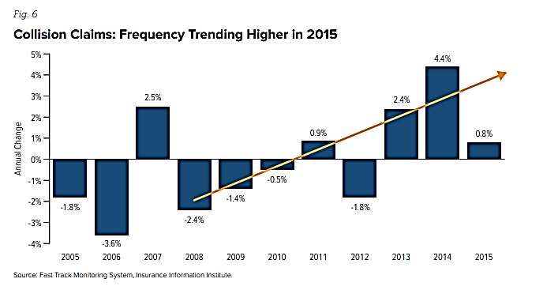
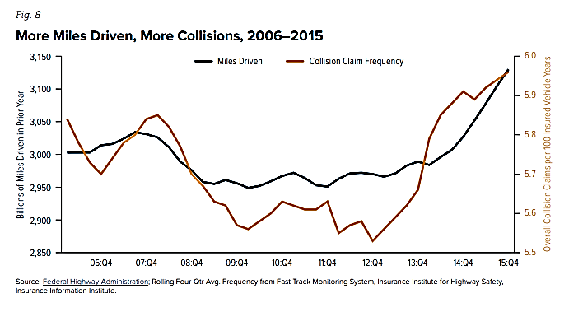
Trends – Rising Frequency
https://www.iii.org/sites/default/files/docs/pdf/auto_rates_wp_092716-62.pdf
Notes:
Explain charts.
We would expect frequency to be going down over time due to things like anti-lock breaks, stronger highway regulations, and increased safety

Slide 11
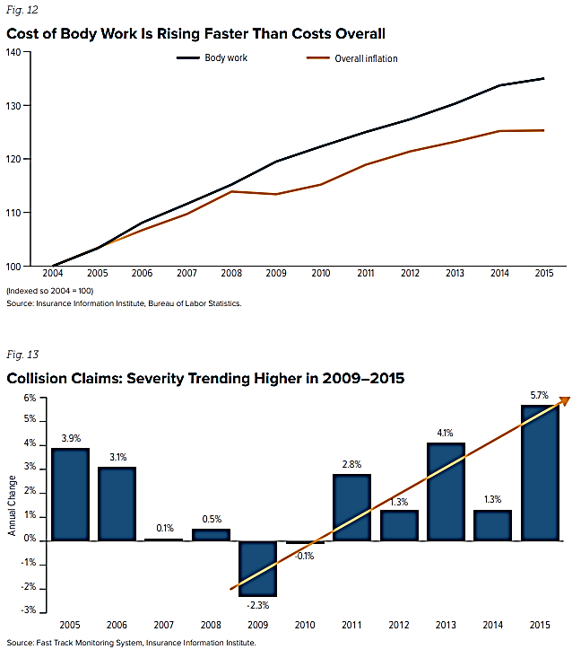
Trends – Rising Severity
https://www.iii.org/sites/default/files/docs/pdf/auto_rates_wp_092716-62.pdf
Notes:
Explain charts
Increase severity because cars cost more to repair or replace

Slide 12
Trends - Summary
StateFarm
  18% underwriting loss in personal auto in 2016
Raise in frequency
  More Jobs = More Driving
  Cheaper Gas = More Driving
  Distracted Driving
Higher claim costs
  More expensive parts
  Spike in traffic fatalities

Slide 13
Insurance Pricing of the Future
Insurance companies are moving from proxy data (categorical data) to source data (about individuals)
UBI is one main tool companies use to personalize pricing.
Companies with systems in place to handle vast amounts of sensor data will be best positioned in the marketplace.
Examples of sensors currently used include:
  Wearable technology
  Sensors on personal and commercial vehicles evaluating safety
  “Smart” home appliances

Slide 14
Impacts of AI in the Future
AI can and will continue to help insurance companies.
Automated Claim Support
  Allow for instant communication, saving customers and insurance companies time and money.
  Cuts out human errors, and prevents fraud through machine learning algorithms.
Damage Assessment
  Machine learning bots can read images and evaluate severity.
Predictive Analytics
  Health insurance companies are providing rewards enticing customers to remain healthy.

Slide 15
Impacts of AI in the Future (ctd.)
Customer Segmentation
  Each customer wants something specific out of their insurance. Classifying customers by their needs allows for better customer satisfaction.
Predicting Customer Lifetime Value (CLV)
  As AI continues to improve, insurance companies will be better able to predict customer behavior, such as retention, based off of customer behavior and attitude.
Marketing
  Insurers can use AI to evaluate which customers to target, using the most effective techniques, such as special days of the year.
  Marketing can also be personalized, matching customer lifestyle.

Slide 16
How insurers can prepare for the future
Focus on improving their AI technologies in every area where data is available.
Develop a long-term plan to implement AI
  Requires investment of money and other resources, but it is essential to stay current with the market.
Organize a system to handle vast amounts of source data
  Due to UBI technologies, source data can give customer specific information.
Stay flexible
  Hiring talent that can adapt to changes in technology.
  Evolving regulation challenges often require unique solutions.

Slide 17
AI Regulation Changes
Due to greater use of personalized data, regulations could restrict types of data collected via UBI sensors.
Rate changes based on personalized data can be difficult to pass through regulation.
Companies like Progressive have used tactics to workaround regulations.
Customer privacy is a challenge for insurers that want more customer data.

Slide 18
Questions to Ponder
WC insurance: What if robots take over upwards of 90% of manual labor jobs
Auto insurance: Once regulation is passed, will automobiles be fully automated? How will premiums be effected?
What if an automated car crashes and kills someone. Who is at fault? How will regulations transition?
Will AI have the ability to fully take over jobs from claims adjusters, underwriters or actuaries?
Notes:
Refer to Uber crash that just killed a pedestrian in AZ

Slide 19
Thank You for Your Attention
Michael Kelch
MKelch@PinnacleActuaries.com
Adam Ramos
ARamos@PinnacleActuaries.com
Sam Heil
SJHeil@ilstu.edu

