Slide 1
Inclusive Practices
Erik C Dreaden, PhD

Slide 2
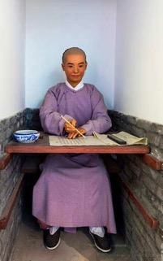
The Science of Personality
Chinese Examination Cells at the South River School (Nanjiangxue) Nanjing (China)
2200 BC
Imperial Examination for govt personnel
every 3 yrs
several hrs per day over several days
1 in 300 pass
Examination hall in Beijing. John Clark Ridpath (1899)
JN Butcher, Oxford Handbook of Personality Assessment, 2009.
Candidates gathering around the wall where the results are posted. This announcement was known as "releasing the roll" (放榜). (c. 1540, by Qiu Ying)

Slide 3
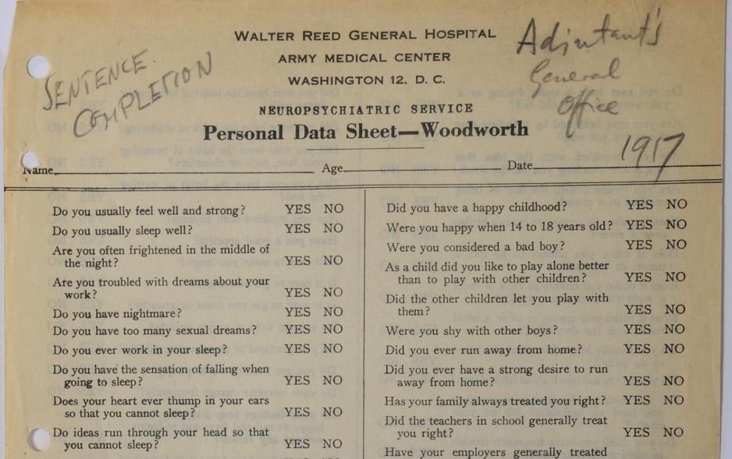
The Science of Personality
1917
Robert Woodworth, PhD
Identified ‘shell shock’ (PTSD)
JN Butcher, Oxford Handbook of Personality Assessment, 2009.

Slide 4
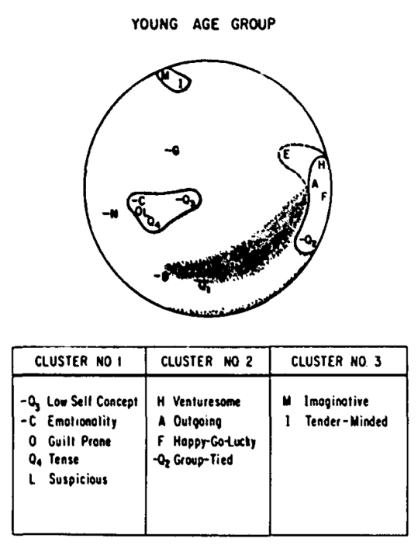
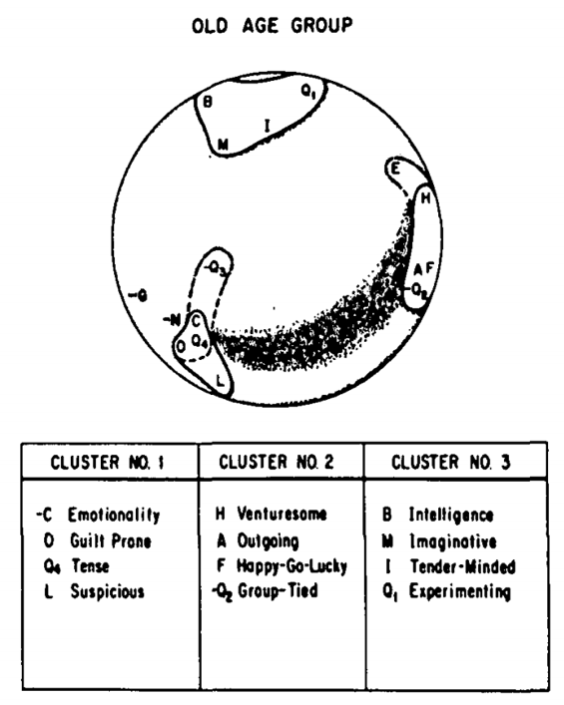
The Science of Personality
1970
Paul Costa & Robert McCrae (NAI)
The Baltimore Longitudinal Study of Aging
Unsupervised clustering, personality v age (link)
1985
Expanded to 5 clusters (The Big Five) and 6 sub-traits (Facets)
Neuroticism
Extroversion
Openness
Agreeableness
Conscientiousness
Costa & McCrae, J Gerontology, 1976 Costa & McCrae, The NEO personality inventory manual, 1985

Slide 5
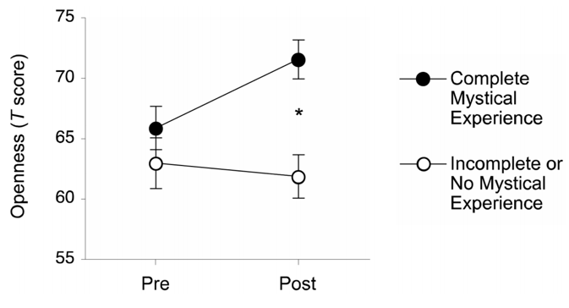
Fun Facts
Agreeableness & Conscientiousness typ increase with age
Extraversion, Neuroticism, & Openness typ decrease with age
Personality clusters correlate w serotonin transporter gene alleles and birth order
Lesch et al. Science, 1996.
Damian et al. J Res Personality, 2015.
FFM used by Cambridge Analytica in election meddling
Harry Davies. The Guardian, 2015.
Openness increases with therapy involving psychedelics
Maclean et al, J Psychophamacol. 2011.
Costa & McCrae, J Gerontology, 1976 Costa & McCrae, The NEO personality inventory manual, 1985

Slide 6
Do-It-Yourself
Most recent update: The International Personality Item Pool (IPIP)
Please take the full-length online exam (30-40min)
Save your results as a pdf & transcribe your numerical scores into the attached Excel worksheet
Print a copy to discuss in group meeting
Learn more about interpreting your results here

Slide 7
Our Experiences
Group discussion of FFM radar plots
Noted group member results in each category
Emphasize shared traits/values
Discuss unexpected results and whether seemingly accurate
Encourage group members to read the guide to interpreting. Traits are more nuanced & complex than a single-word description might imply
Encourage members to answer truthfully (and/or quickly) for accuracy
Pay attention to anxiety, anger, depression, emotionality, cooperation, etc

Slide 8
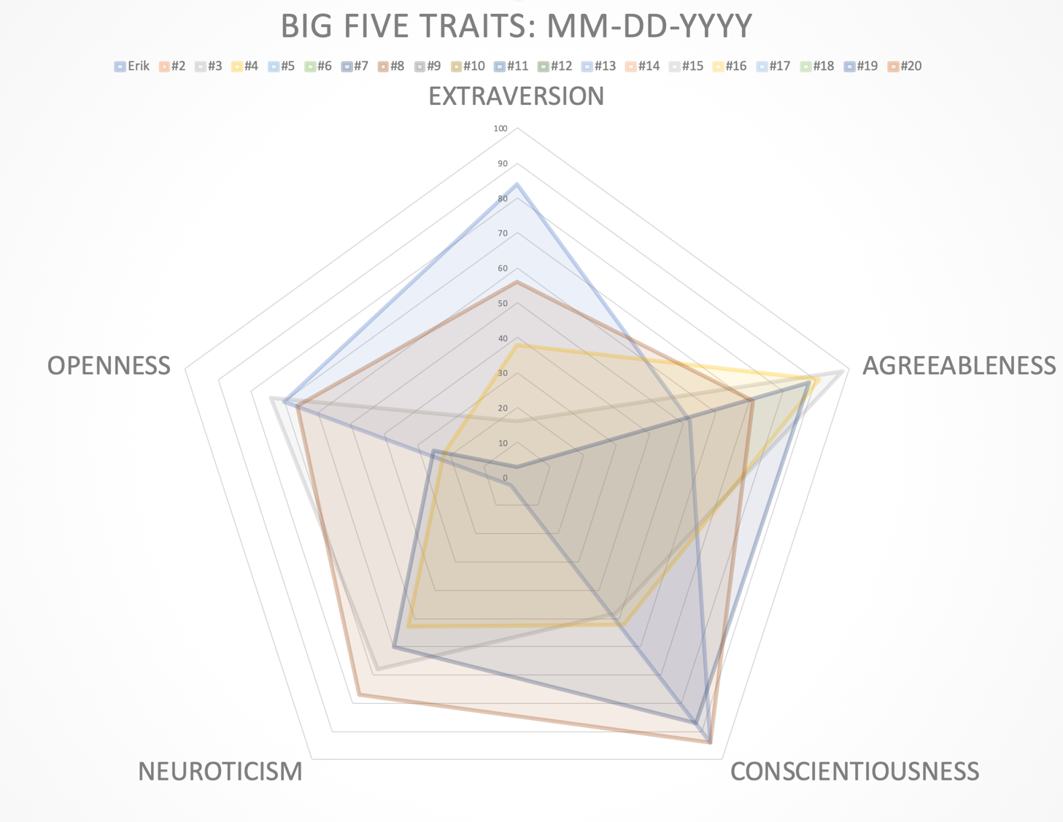
Our Experiences
Everyone
Agreeable
Strength or Weakness

Slide 9
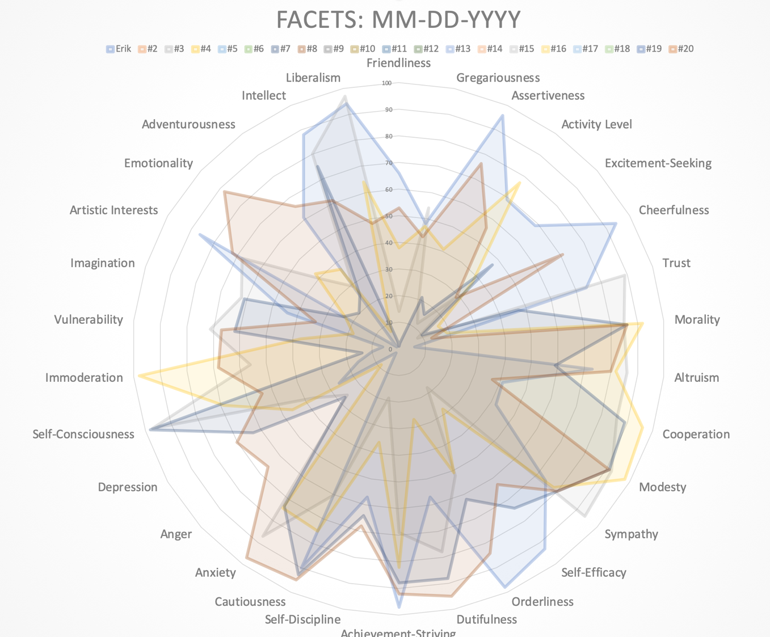
Watch
Watch
Watch
Watch
Surprising

Slide 10
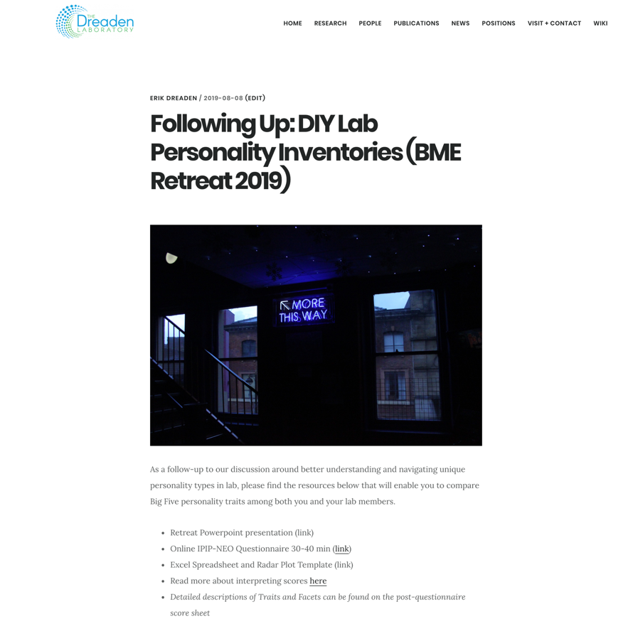
Additional Resources
dreadenlab.gatech.edu
See: News>Today’s Date
PowerPoint presentation
Radar Plot Template (Excel)
The Birkman Method
Moderated, 3-4 hr workshop ($$$)
Tami Hutto
(tamara.e.hutto@emory.edu)

