Slide 1
Enabling Technologies and Innovation R&D at Texas A&M University
Pavel Tsvetkov
Nuclear Engineering
Texas A&M University

Slide 3
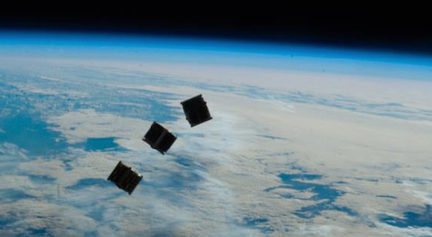
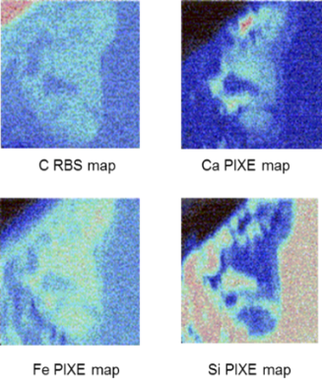
Enabling Technologies and Innovation R&D at Texas A&M University
Thrust Areas 1 and 3: Multi-Modal Global Surveillance
Mario Mendoza*, Pavel Tsvetkov (Texas A&M)
Troy Guy, Michael Lewis (NanoRacks, LLC)
Benjamin Cipiti (Sandia National Laboratories)
Thrust Area 2: Methods for Ion Interrogation and Signature Analytics and Development
Miguel Pena*, Lin Shao, Frank Garner (Texas A&M)
Benjamin Cipiti (Sandia National Laboratories)

Slide 4
Thrust Area 1 (and 3): Multi-Modal Global Surveillance for Predictive and On-Demand Characterization of Localized Processes Using Cube Satellite Platforms
Program – integration of computational and experimental elements towards:
Analysis
Development
Prototype design of a system to be launched from the International Space Station (ISS)

Slide 5
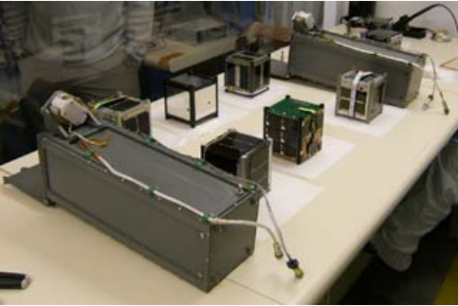
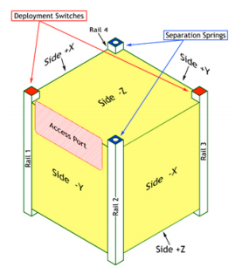
CubeSat architecture
CubeSats are measured in units of U, 1U is equal to 10 cm x 10 cm x 10 cm cube with a mass close to 1 kg
Sizes range from 1U to 12U
Most likely size for including a high-resolution sensor is 3U
High-resolution sensing (spectral and spatial, etc.)
Data analysis and reconstruction methods
10 cm

Slide 6
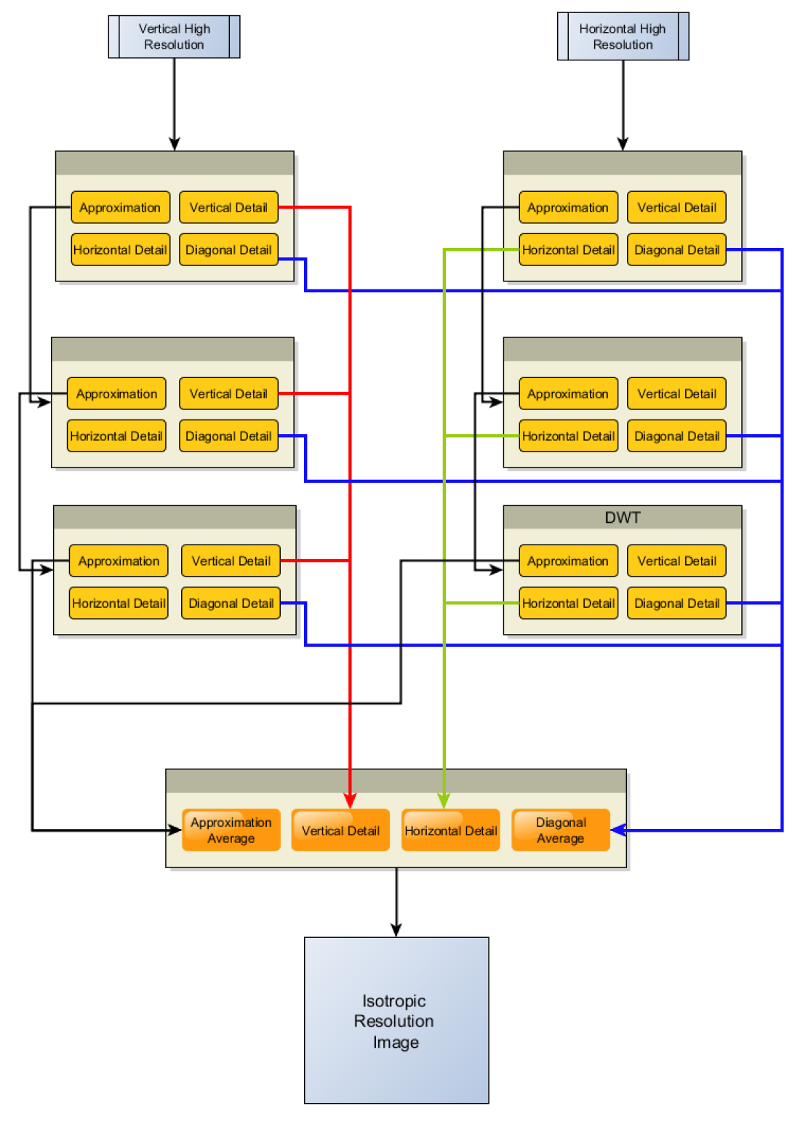
Phenomena Signature Analytics
Feature characterization
Surveillance
Data synthesis and reconstruction
Interpretive analytics
Use of artificial intelligence methods (smart automation and global 3D interrogation)

Slide 7
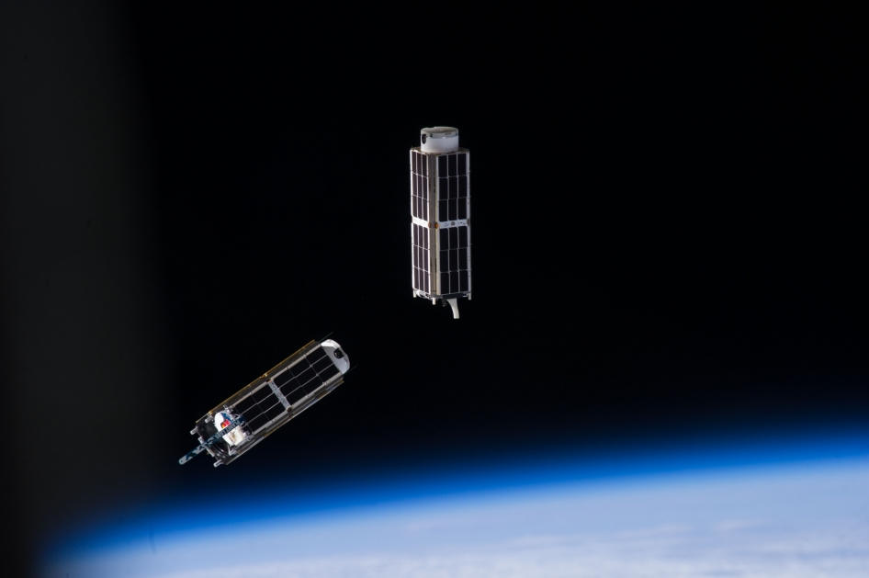
Data analytics and reconstruction
Big Data management
Characterization and prediction
Automated (smart) surveillance
Multi-modal spectral interrogation:
High-resolution remote sensing
Unique signatures for characterization and identification
Demonstrations
using available data sets and hi-res. imagery
Aerial phenomena sensing
Atmospheric phenomena
Photo Credits: National Aeronautics and Space Administration (NASA) https://www.nasa.gov/mission_pages/cubesats/overview

Slide 8
Timeline
The effort is focused on science and technology of predictive and on-demand characterization of localized developments on the earth surface, subsurface and within atmosphere:
Task 1: CubeSat-based global surveyor architecture development
Task 2: Specification development for a CubeSat-based global surveyor
Task 3. Computational and experimental program based on surrogate and simulated data sets demonstrating capabilities of the orbital surveyor platform
Task 4. CubeSat design and data analysis towards a future demonstration launch program

Slide 9
Task 1: CubeSat-based global surveyor architecture development
1.1. CubeSat configuration and platform capabilities
1.2. Instrumentation options analysis for CubeSat based surface and atmospheric surveys
1.3. Enabling data analysis methods to support data fusion, reconstruction, and predictive analysis
1.4. Multi-modal signature development accounting for high resolution remote sensing data streams
1.5. Prototype concept and computational analysis to demonstrate capability*

Slide 10
Task 2: Specification development for a CubeSat-based global surveyor
2.1. CubeSat very high-resolution sensing options with focus on optical image analysis, reconstruction and signature development
2.2. Multi-modal spectral signature analysis options in CubeSat architectures
2.3. Hardware specification development and integration options analysis

Slide 11
Task 3: Computational and experimental program based on surrogate and simulated data sets demonstrating capabilities of the proposed orbital surveyor platform*
3.1. 3D surface and atmospheric mapping method with dynamic feature localization and analysis
3.2. CubeSat surveyor performance model and data simulation
3.3. Data analytics demonstration program based on high-resolution multi-modal signatures (land and atmospheric mapping, feature extraction, object recognition) – human activity localization, activity detection and interpretation with resolutions higher than 5m.

Slide 12
Task 4: CubeSat design and data analysis towards a future demonstration launch program
4.1. Data analysis and data acquisition system development and specification in support of the CubeSat surveyor architectures
4.2. Data analytics methods including fusion (spatial, spectral, scale-space adaptations) and machine learning based on Cube Sat data streams
4.3. Design of a CubeSat-based global surveyor and the launch program development

Slide 13
Impact and Outcomes: using existing and future space platforms to advance global observation and surveillance science
The use of orbital survey methods offers access options for any location in 3D from subsurface up to upper atmosphere, continuously and over discrete periods of interest
The project is a synthesis of high TRL observational platforms (cube satellites) with lower TRL sensors and predictive methods including fusion and machine learning to yield a robust multi-modal surveillance and prediction capability
The process signature development is an integral part of the effort. The results will be widely applicable for all survey programs where signatures are needed to characterize developing local phenomena remotely.
The Cube Sate surveyor solves the challenge of access to the location of interest.

Slide 14
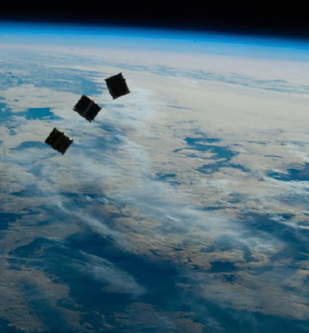
Thank You!
Pavel Tsvetkov
tsvetkov@tamu.edu

