Slide 1

Wide and Ultra-Wide Bandgap Semiconductor Devices, Sensors & Circuits: Reducing SWaP
Steven A. Ringel
Distinguished University Professor
Director, Institute for Materials Research
Associate Vice President for Research
The Ohio State University

Slide 2







Ohio State Team
Raymond Cao (OSU lead)
Anant Agarwal
Aaron Arehart
Siddharth Rajan
Steve Ringel
Growth
Fabrication
Characterization
devices
Modeling
Design
Evaluation
materials
4H-SiC
GaN
β-Ga₂O₃
sensors
circuits

Slide 3
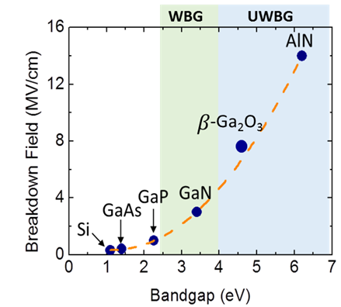
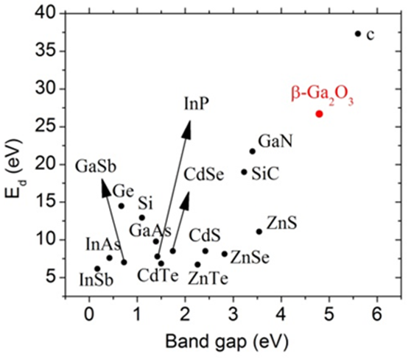
OSU Primary Focus On Wide/Ultra-Wide Bandgap (WBG/UWBG) Devices
Objective/Goals:
Fabricate, test, demo and optimize WBG/UWBG semiconductor based sensors, devices, front-end circuits:
4H-SiC (Most mature)
GaN
β-Ga₂O₃ (Emerging)
Motivation:
Extremely low dark current
Very high radiation tolerance
  Enables harsh environment communications and signal processing @ reduced size, weight and power (SWaP)
Notes:
Motivation slightly overlaps with slide 5.

Slide 4
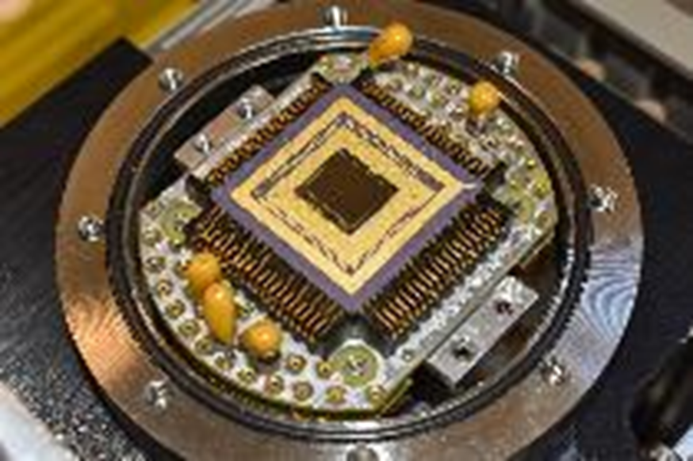
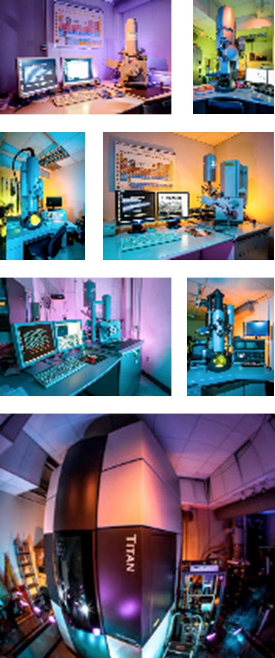

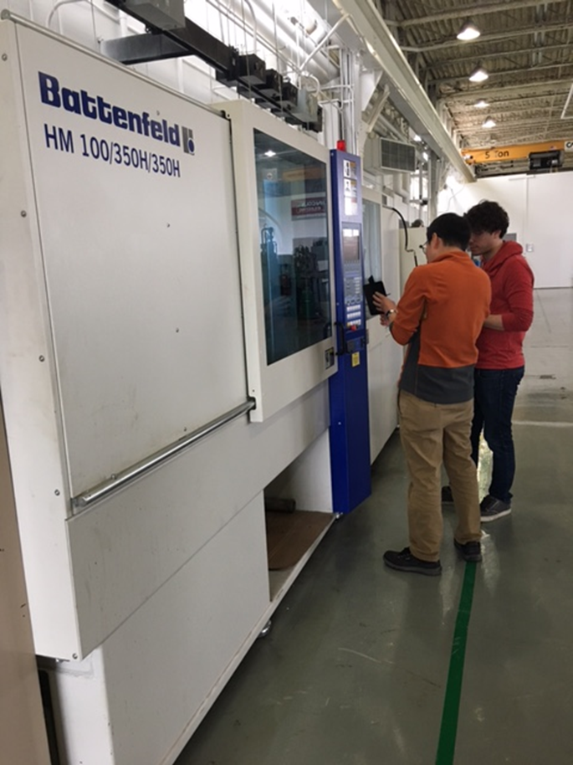
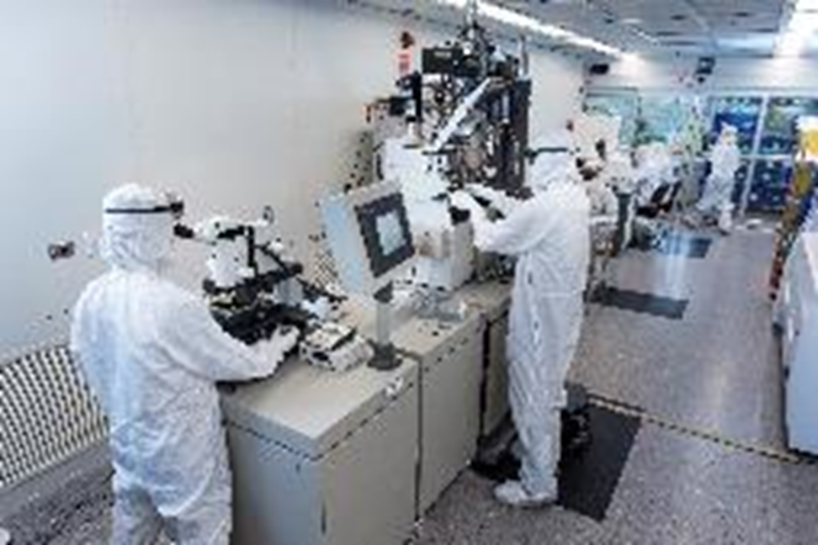

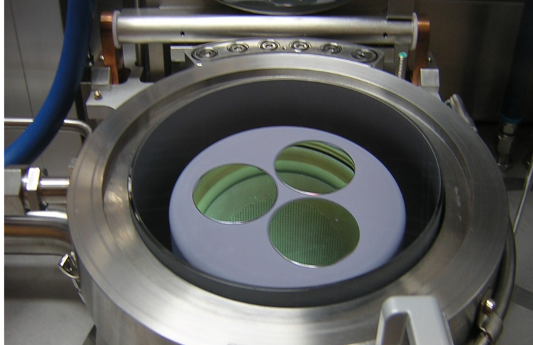

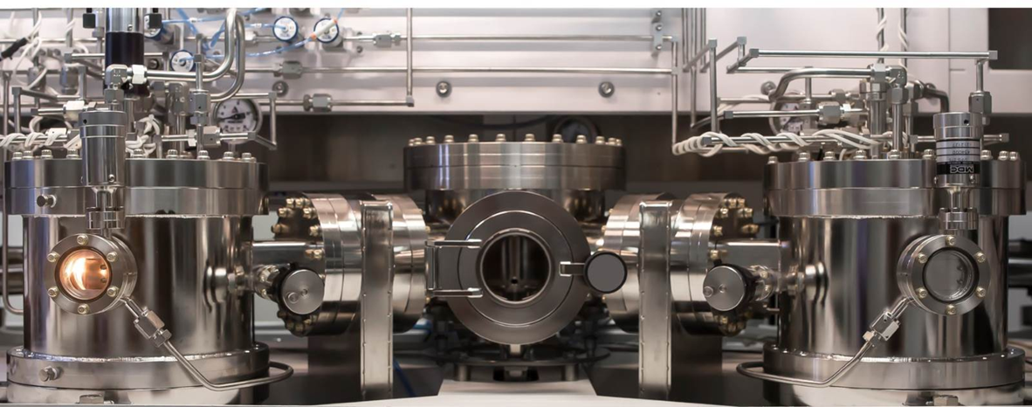
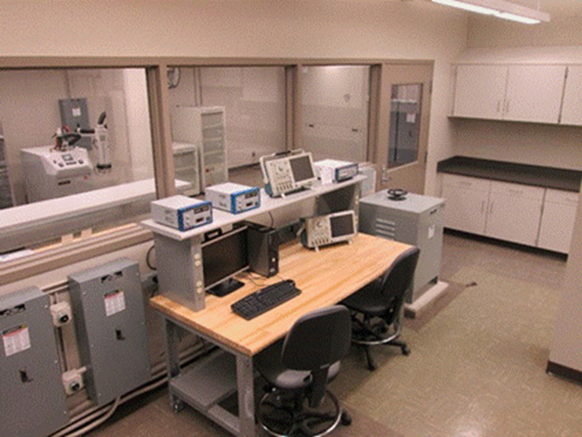
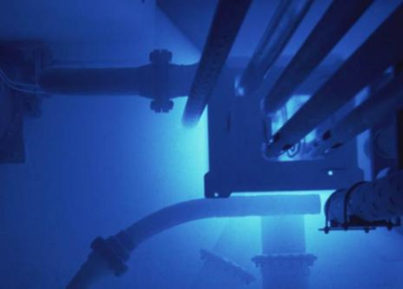
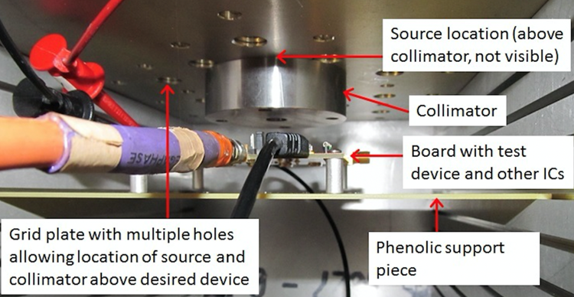
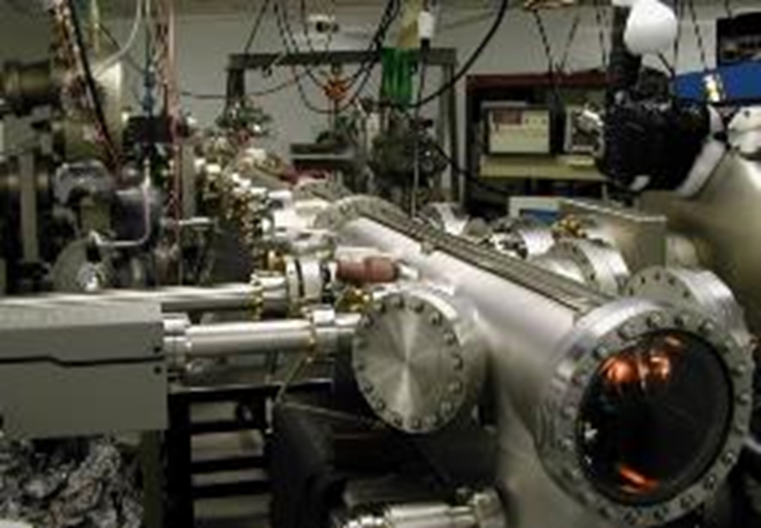
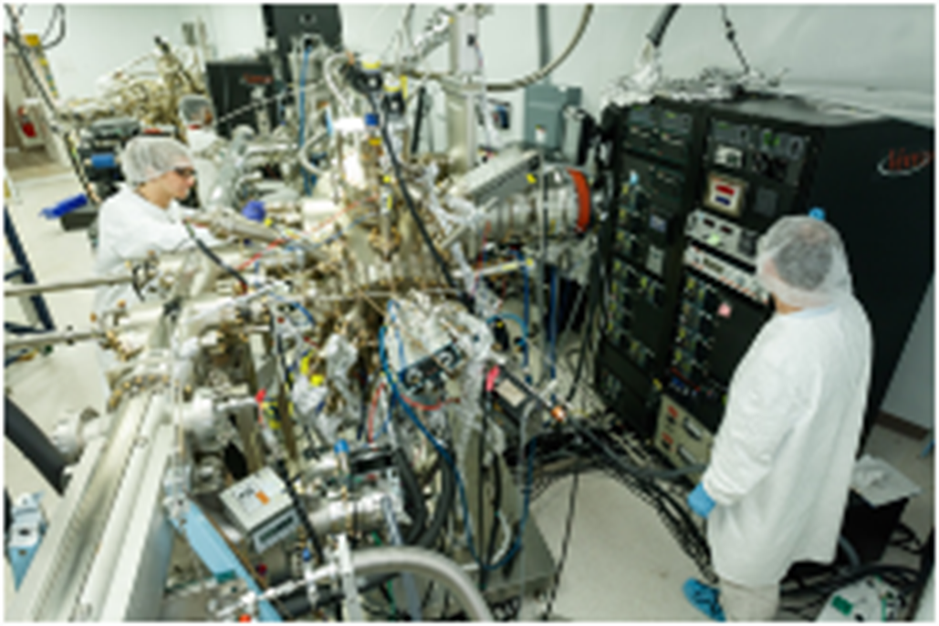
Ohio State Relevant Capabilities

Slide 5
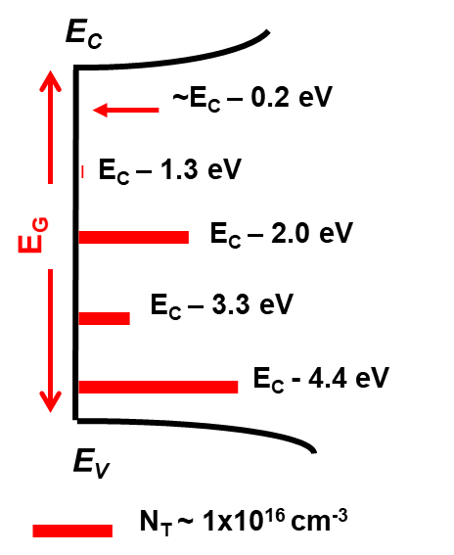
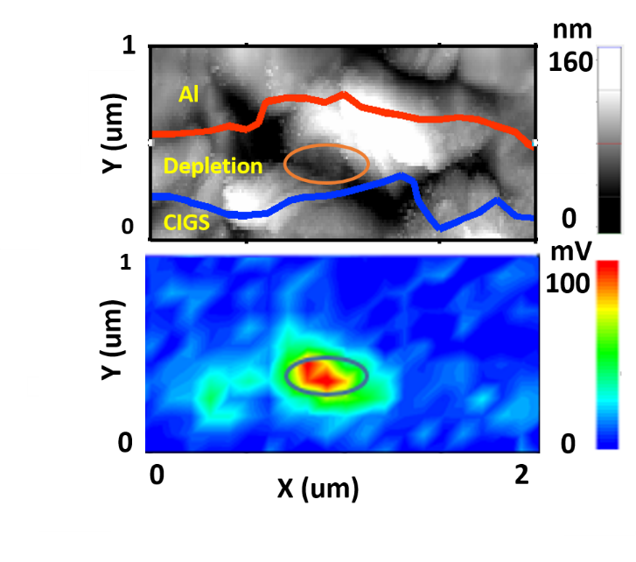
Trap spectroscopy capabilities
Capabilities:
Largest known DLTS/DLOS lab in the US
Up to 2 kV for PIN, power devices, …
6.5 – 650 K temperature range
Measure: C, R, G, Y, I, V
DC – 50 GHz
Useful for bulk, interfaces, correlating device behavior to traps
DLTS/DLOS:
Quantitative trap conc.
Trap energies wrt band edge
Full bandgap characterization
Parts per trillion sensitivity
Defect spectroscopy directly on commercial transistors:
Trap modulation can be deep into buffer/substrate using Drain – controlled CI_{D}-DLTS
Source
Gate
Drain
Trap modulation in channel using Gate-controlled CI_{D}-DLTS
Scanning-DLTS:
Nanometer range spatial res.
Quantitative trap conc.
Parts per trillion sensitivity
Trap energies wrt band edge

Slide 6
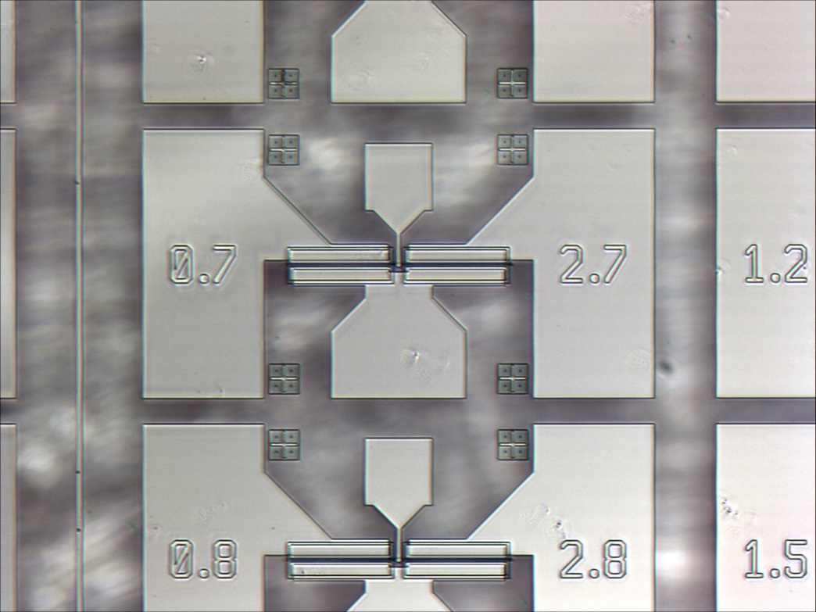
Why GaN, 𝛽-Ga₂O₃ & SiC
WBG & UWBG materials, devices, and circuits
High radiation tolerance
  Strong chemical bonding leads to high rad hardness
Wide Eg → Ultra-low leakage currents/large junction barriers
Extreme environments (temperature, chemicals)
  Relatively chemically inert
High standoff voltages
Communication/logic (GaN and β-Ga₂O₃)
  Direct bandgap allows integrated optical devices
β-Ga₂O₃ (least mature)
Melt grown → cheap → easy to have very thick devices
Native substrate → potential for low defect densities
GaN
University proto-type foundry at OSU for simple devices
Device models for monolithic sensor/readout
SiC (most mature)
High yield → large arrays possible

Slide 7
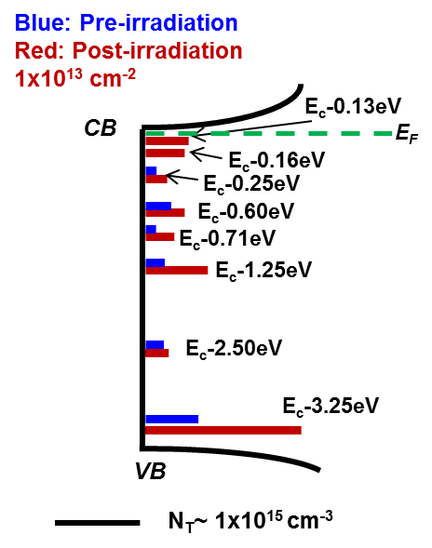
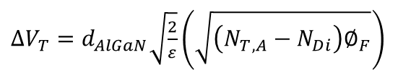
GaN radiation response and modeling
Defect characterization before/ after irradiation
Example of trap impact Predicting threshold voltage shifts vs fluence
Directly measure influence of traps on device performance
Unstressed
CI_{D}-DLTS
E_{C}-1.0 eV
E_{C}-0.57 eV
Stressed
Trap impact on RF P_{OUT}
Analytic model for multiple particles simultaneously:
$∆V_{T}=d_{AlGaN}\sqrt{\frac{2}{ε}}\left(\sqrt{\left(N_{T,A}−N_{Di}\right)∅_{F}}\right)$
Notes:
Nt is then proton fluence * proton carrier comp. rate + neutron fluence * neutron carrier comp. rate - electron fluence * electron carrier comp. rate since electrons create more donors than acceptors it is a subtraction.

Slide 8
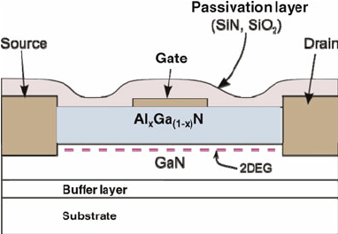
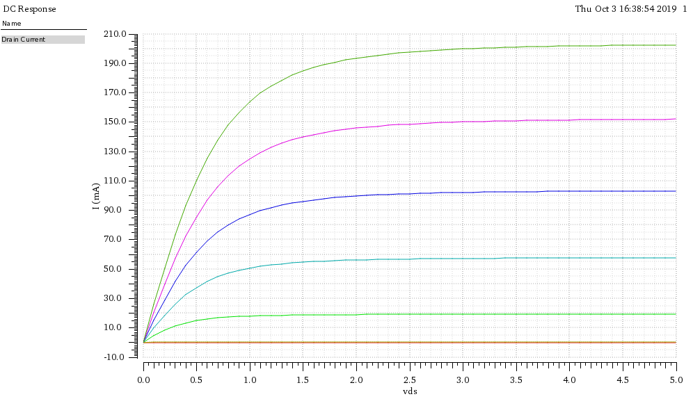
GaN Devices & Circuits
Source: https://www.researchgate.net/publication/231909169_Overview_of_AlGaNGaN_HEMT_technology_for_L-_to_Ku-band_applications
Development of GaN-based circuits
Objective: To develop GaN-based front-end electronics with radiation-hard properties that can function in extreme environments
  Very tolerant to V_{T} shift, leakage currents due to radiation damage
  Experimentally-informed design, simulation & optimization of GaN HEMT-based monolithic circuits for logic and analog applications
  Experimental demonstration of radiation tolerance of fabricated GaN circuits

Slide 9
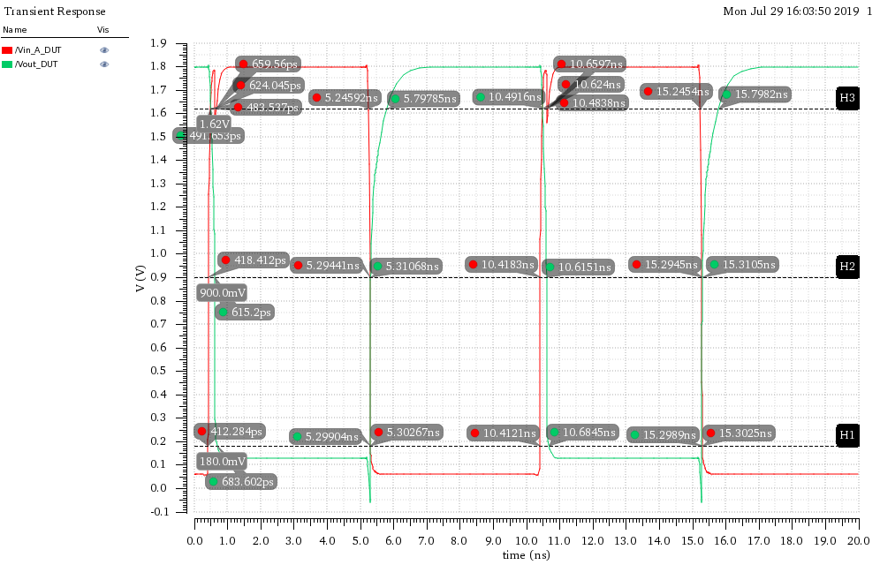
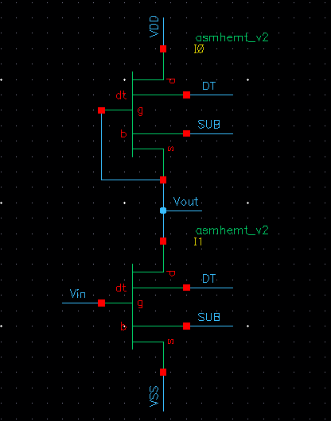
GaN Circuit Development
Current status ( see poster: Ashok Dheenan)
Implemented compact models for enhancement & depletion-mode GaN devices
Device models used to simulate performance of basic NAND/NOR/INV logic gates
Clean room process flow for GaN logic circuits is being developed
E/D mode and CMOS will be explored
Complementary
D
S
G
D
+++++++++++++++++++++++++
S
G
P-GaN
2DHG
Al_{x}Ga_{1-x}N
Al_{y}Ga_{1-y}N
2DEG
GaN
GaN
Substrate (Sapphire, Si, or SiC)
Enhancement/Depletion Mode
S
G
D
S
G
D
Al_{x}Ga_{1-x}N
Al_{x}Ga_{1-x}N
2DEG
2DEG
GaN
GaN
Substrate (Sapphire, Si, or SiC)

Slide 10
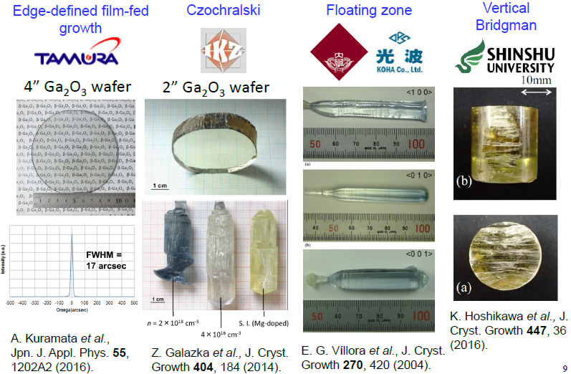
β-Ga₂O₃: An Emerging UWBG Technology
𝛽-Ga₂O₃ based radiation sensors
Bulk 𝛽-Ga₂O₃ substrates are commercially available. Low background doping (< 10¹⁶ cm⁻³) and bulk substrates enable low dark current
Previous OSU experience on 𝛽-Ga₂O₃ for low leakage Schottky diodes will be leveraged for radiation sensors
Thick epitaxial (MOCVD, LPCVD & HVPE) Schottky diodes
Pt/Au/Ni
L_{FP}
Ti
φ
t
SiO₂
∼2um n⁻ β-Ga₂O₃
Sn doped β-Ga₂O₃ (010) substrate
Ti/Au/Ni
Joishi, Chandan, et al., Applied Physics Express 11.3 (2018): 031101.
Schottky barrier diode
Notes:
Add transistor from aaron notes and siddharth

Slide 11
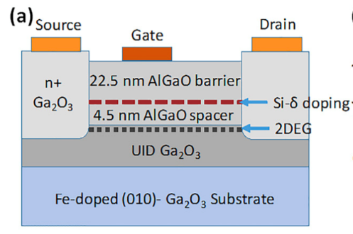
β-Ga₂O₃ transistor status at OSU
Modulation Doped (Al_{0.2}Ga_{0.8})₂O₃/Ga₂O₃ FET
Delta-doped MESFET with 120 nm T-shaped gate
Peak current density of 260 mA/mm and peak transconductance of 44 mS/mm are achieved.
Breakdown voltage is 150 V
f_{T} = 27 GHz & f_{MAX} = 16 GHz
Three terminal characteristics
  I_{DMAX} = 180 mA/mm, I_{ON}/ I_{OFF} ~ 10⁷
F_{AVG} = 3.9 MV/cm
For L_{GD} = 16 µm, V_{BR} = 1370 V
Breakdown due to tunneling from the Schottky gate
OSU – Y. Zhang et al. APL 112, 173502 (2018)
Z. Xia, IEEE Electron Device let.40, 7 (2019)

Slide 12
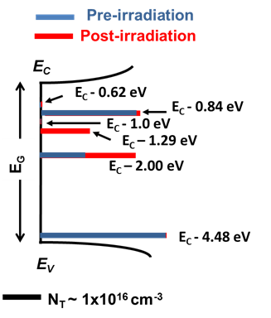
β-Ga₂O₃: Radiation (neutron, proton) Effects
β-Ga₂O₃ Schottky barriers very ideal
Low leakage current
High radiation tolerance
No special structures like guard rings yet
Devices shown to block >3 kV (still ~1/3 of theoretical electric fields) [1]
Irradiation leads to carrier compensation
Mostly due to E_{C}-2.0 eV trap
Likely V_{Ga} (ultra-resolution TEM/DLOS/DFT)
Z. Hu et al, EDL 39, 1564 (2018).
Farzana, APL Materials 7, 022502 (2019)
Farzana, APL (accepted with minor revision)

Slide 13
Si CMOS Photodiode Active Pixel Sensor (APS): Analogue for SiC?
1.3-Mpixel Pinned Diode APS Example

Slide 14
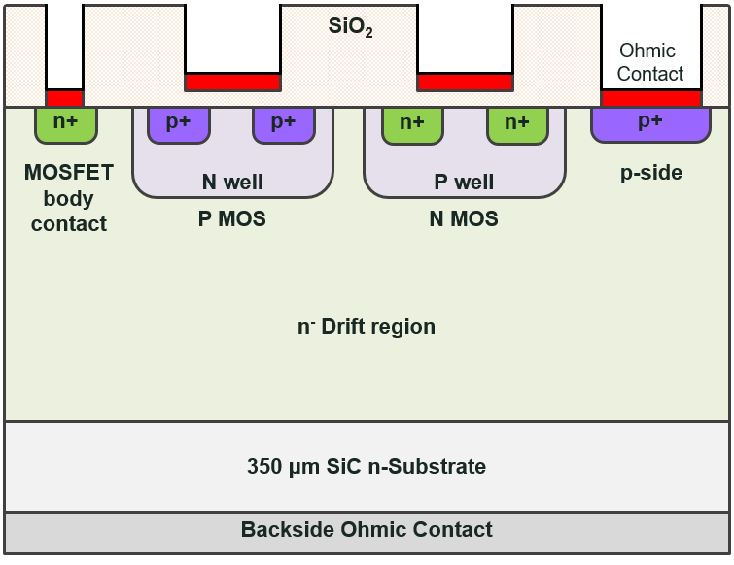
SiC CMOS-based Active Pixel Array
Goal: Design/Fab/Test a SiC Neutron Camera
Pinned Diode APS
SiC CMOS Implementation

Slide 15
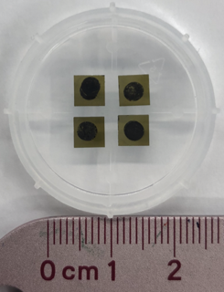
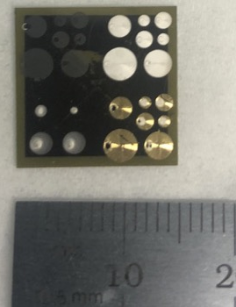
Direct writing of metal contacts on SiC for radiation sensors (next talk-Neil Taylor)
Goal: develop rad-hard sensor for nuclear fuel cycle monitoring
Progress:
Aerosolized metal nanoparticle ink Schottky diode printed on SiC substrate
Alpha spectrum measured with resolution of 3.32% @5.5 MeV – promising 1st step (~ 0.4% for standard Pt Schottky)
Next step: understand the metal/semiconductor interface, optimize printing
Metal printed SiC sensor (collab with ORNL)
Taylor, Neil R., et al. "Direct printing of metal contacts on 4H-SiC for radiation detection." AIP Advances 9.9 (2019): 095041.
Notes:
These sensors were printed using an Optomec Aerosol jet 200 and 300 printer in collaboration with Pooran Joshi from the Oak Ridge National Lab.
The metal nanoparticle ink is aerosolized and then deposited onto the substrate using flow gases and a specialized nozzle.
The printer has a resolution of 10 microns and can print metals, dielectrics, biological material, resistors, and carbon nanotubes.
The design is first created using a CAD software and the design is then filled with the desired line width and overlap of the print.
The printing process can take anywhere from just a few minutes to a half hour for very large patterns.
The samples rest on a heated platform during printing and then require a curing process to properly dry the ink.
Following the printing, the devices are brought back to Dr. Cao’s Nuclear Analysis and Radiation Sensors Lab at The Ohio State University where they are tested for their electrical and spectroscopic performance.
Forward IV, reverse IV, and capacitance-voltage measurements are all taken to characterize the diode behavior of the contacts.
The spectroscopic performance of the device is tested using alpha particle sources and a vacuum chamber.

Slide 16
Conclusions and Plans
Funding just arrived; OSU subcontract being established, but promising initial results and leverage
SiC – mature and can scale now
  One pixel with 3 transistor cells and a high voltage SiC P/N diode has been designed along with many test structures; fab/test of pixel in 6 months
  Direct metal writing is ongoing
GaN – near term impact
  Digital circuit elements to determine yield; leading to analog
  Integration of defect parameters
  Prototype foundry process being established (PDKs, etc)
β-Ga₂O₃ – emergent “ultimate” technology
  Refining radiation defect/device models
  Focus on MBE, substrates, and thick MOCVD or LPCVD for sensors
  Evaluate vs alpha, gamma, and neutrons; and model performance
Notes:
Note done

