Slide 1
Properties of Light
When light strikes an object it is:

Slide 2
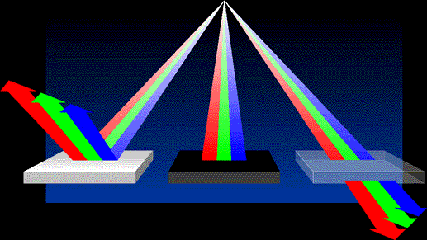
Properties of Light
When light strikes an object it is:
  Reflected

Slide 3
Properties of Light
When light strikes an object it is:
  Reflected
  Transmitted

Slide 4
Properties of Light
When light strikes an object it is:
  Reflected
  Transmitted
  Absorbed

Slide 5
Properties of Light
What happens to the light depends on the material

Slide 6
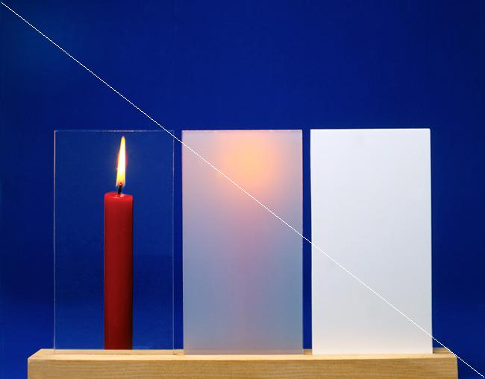
Properties of Light
What happens to the light depends on the material
  Transparent (clear) materials- transmit light

Slide 7
Properties of Light
What happens to the light depends on the material
  Transparent (clear) materials- transmits light
  Translucent (see through) materials- scatters the transmitted light

Slide 8
Properties of Light
What happens to the light depends on the material
  Transparent (clear) materials- transmit light
  Translucent (see through) materials- scatters the transmitted light
  Opaque (not see through) materials- absorbs and reflects

Slide 9
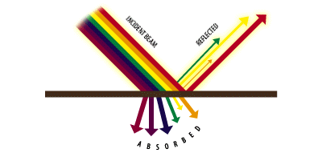

Properties of Light
Color of objects is the color it reflects
  Ex- an orange is orange because it absorbs every color BUT orange, instead it reflects orange

Slide 10
Properties of Light
Color of objects is the color it reflects
  Ex- an orange is orange because it absorbs every color BUT orange, instead it reflects orange
  If you do not shine orange light on it, it will appear black

Slide 11
Properties of Light
Color of objects is the color it reflects
  Ex- an orange is orange because it absorbs every color BUT orange, instead it reflects orange
  If you do not shine orange light on it, it will appear black
  Black is the absence of color, white is the blending of all colors

Slide 12

Properties of Light
Reflection- when an object or wave bounces back off a surface

Slide 13
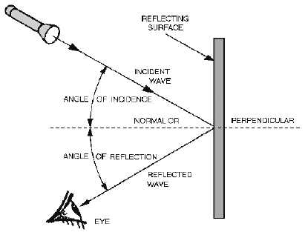
Properties of Light
Reflection- when an object or wave bounces back off a surface
Law of reflection- angle made from incoming wave = the angle made from reflected wave

Slide 14
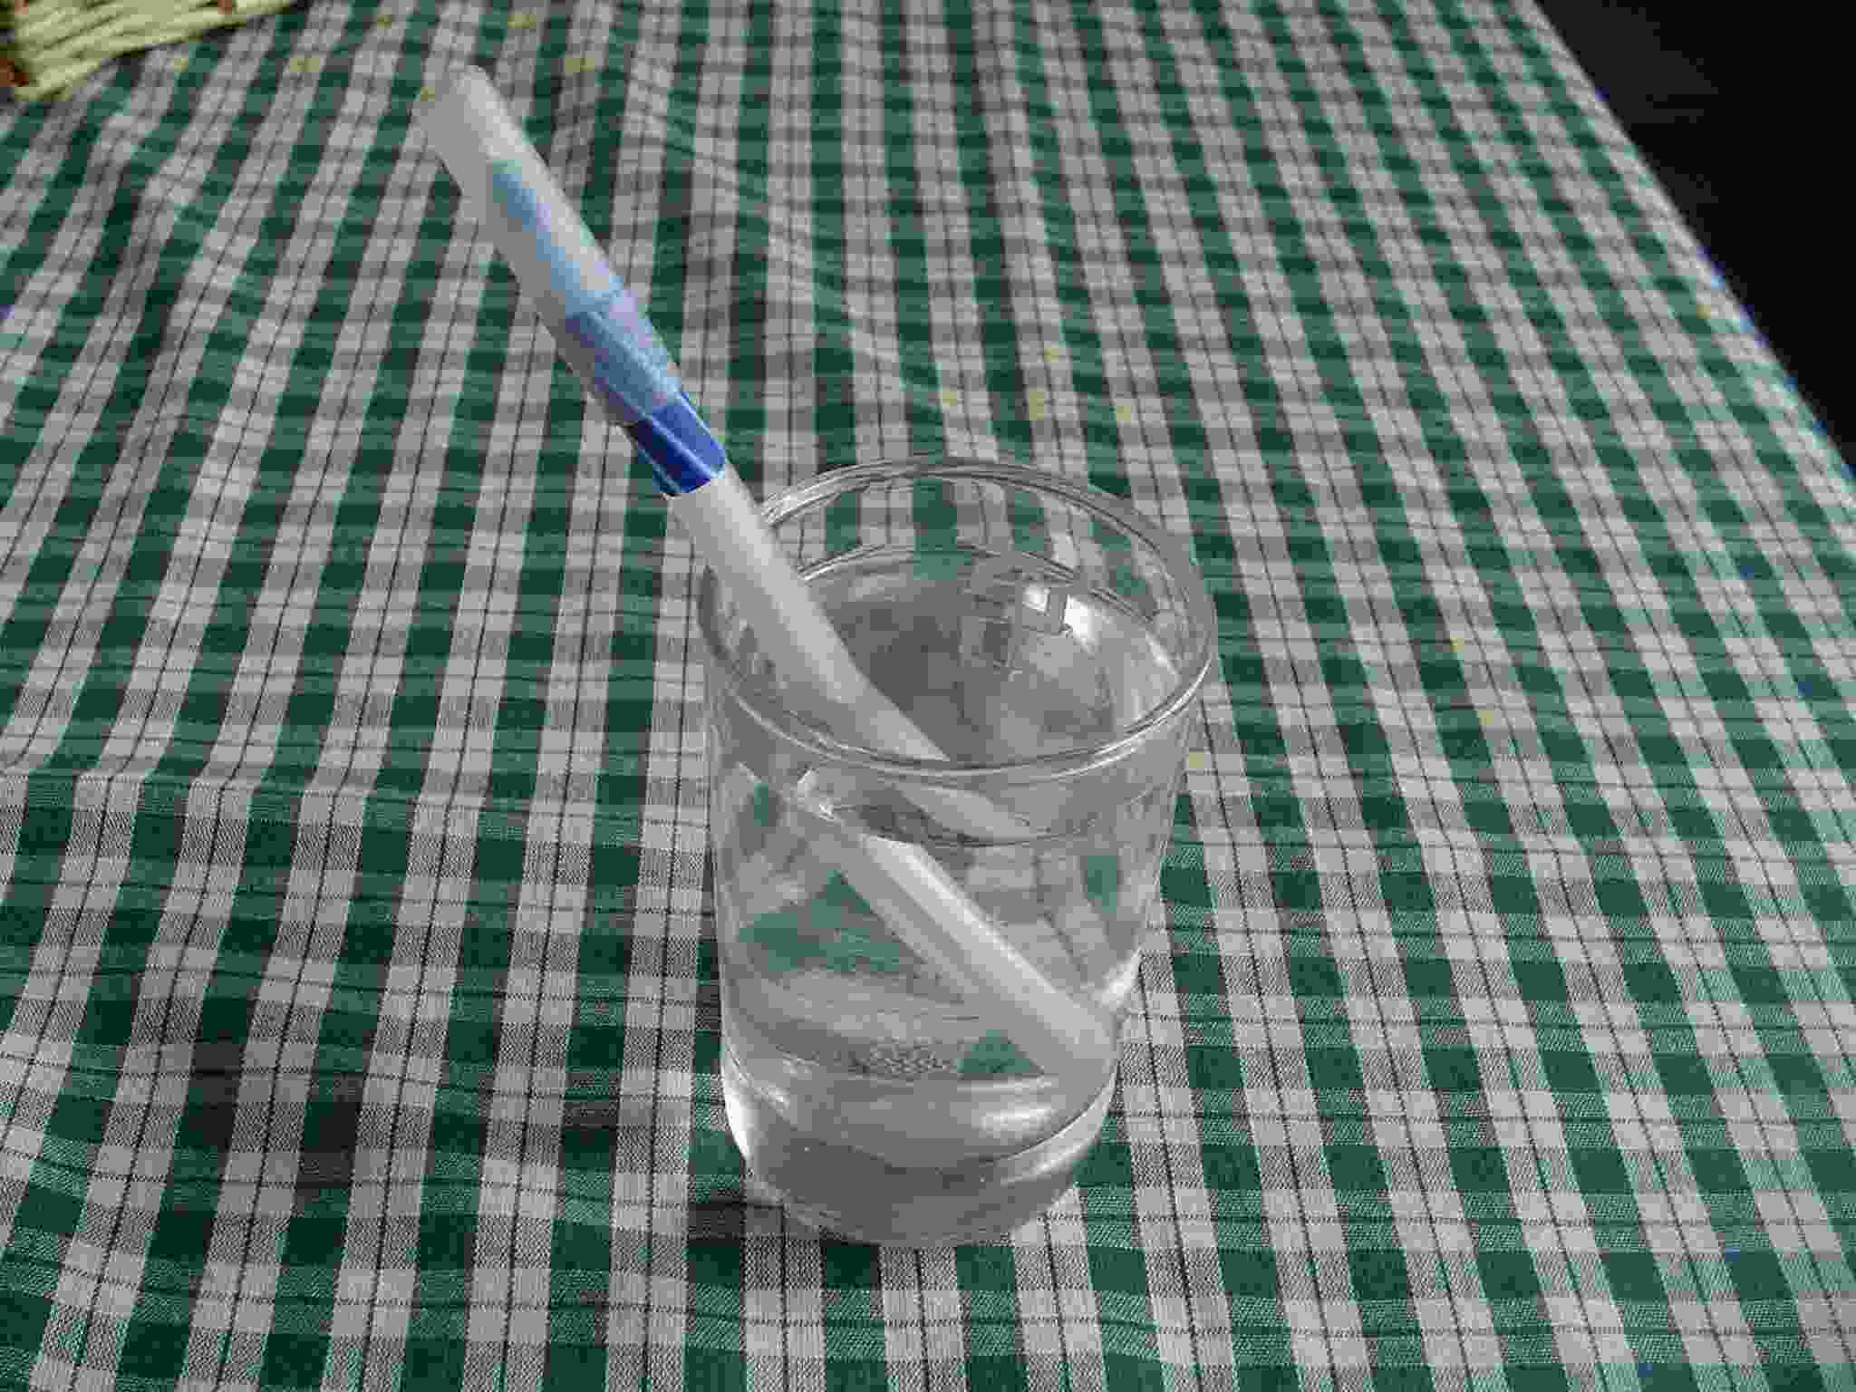
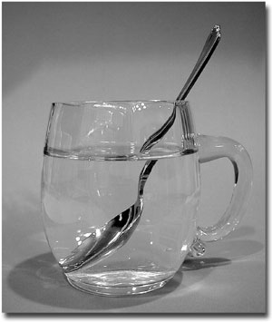
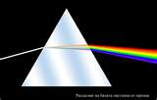
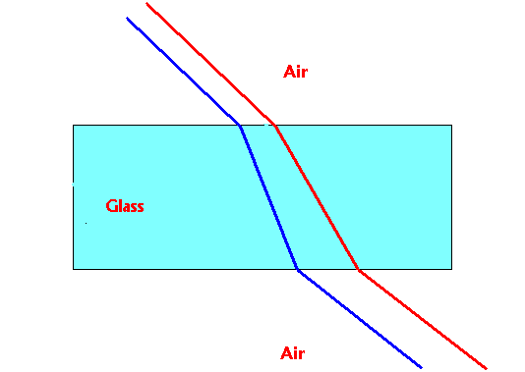
Properties of Light
Refraction- bending of light waves due to a change in speed

Slide 15
Properties of Light
Refraction- bending of light waves due to a change in speed
Lens- curved glass or transparent material that refracts light

Slide 16
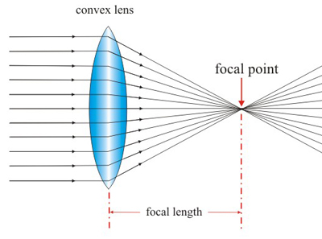
Properties of Light
Refraction- bending of light waves due to a change in speed
Lens- curved glass or transparent material that refracts light
Convex lens- thicker in the center than the edges (bends light in)

Slide 17
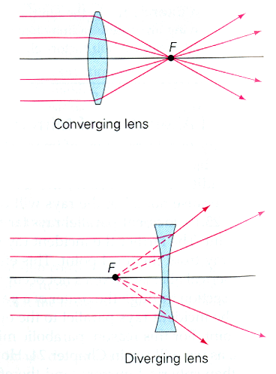
Properties of Light
Convex lens- thicker in the center than the edges (bends light in)
Concave lens- thinner in the center than the edges (bends light out)

