Slide 1




Slide 2



Ben Raines, Program Coordinator
Raines.56@osu.edu
FREE ● CONFIDENTIAL ● FOR EVERYONE
Student Wellness Center - RPAC
go.osu.edu/yourfinances
@SGFOSU
Notes:
Questions?

Slide 3


Financial Health
Budgeting
Student Loans
Banking
Credit Cards
Credit Reports
Identity Theft
Your Paycheck
Investing
Health Insurance
9 Financial Wellness Modules
FREE for anyone with OSU email @ www.igrad.com

Slide 4
EDUCATIONAL SERVICE ONLY; NO ADVICE IS PROVIDED
Scarlet and Gray Financial Coaching is an educational service only. We do not provide investment, legal, debt consolidation, debt management or tax advice. The information provided is for general educational purposes only, and is not intended to substitute for the advice of your investment, legal, tax advisors and/or credit counselors or to be the basis of specific trading, investment or debt consolidation and management activities. If you need investment, legal, tax advice, and/or credit counseling, please consult with one of these professionals.
The links to third-party financial resources are provided as a convenience for informational purposes only. Neither The Ohio State University or its Student Wellness Center endorses or approves any of the products, services or opinions of the entities or individuals associated with these links. The Ohio State University and its Student Wellness Center bear no responsibility for the accuracy, legality or content of any external site associated with the links provided or any subsequent links.

Slide 5

TOPICS
Retirement Overview
OPERS & ARP
After OSU

Slide 6
Why save for retirement?
Pension?
Social Security?
Your Savings

Slide 7
What is a pension?
A pension is a fund into which a sum of money is added during an employee's employment years, and from which payments are drawn to support the person's retirement from work in the form of periodic payments.
Notes:
-Contribute up to employer match!

Slide 8
What is social security?
The OASDI (old-age, survivors, and disability) program—which for most Americans means Social Security—is the largest income-maintenance program in the United States. Based on social insurance principles, the program provides monthly benefits designed to replace, in part, the loss of income due to retirement, disability, or death.
This is funded by payroll taxes – Ohio public employees DO NOT pay into SS but may be eligible from previous jobs or have access to spouse’s benefits
Notes:
-Contribute up to employer match!

Slide 9
Retirement Savings 101
Workers save money and invest throughout their career with the goal of having a large pool of money with which to live on in retirement.
Generally in self-directed investment accounts.
Pre-tax: reduces your taxable income, taxable at retirement
Post-tax: income has already been taxed, tax free at retirement
Notes:
-Contribute up to employer match!

Slide 10
Work Sponsored Pre-Tax Investment Accounts
Commonly 401(k), 403(b), 401(a)
$19,000 annual contribution limit
Usually a match
Can withdraw without penalty at 59.5
Notes:
-Contribute up to employer match!

Slide 11
Individual Retirement Account
Traditional IRA – pre tax - $6,000
Roth IRA – post tax – $6,000
    Flexible, big benefit later
  Can open about anywhere
  59.5 withdraw except Roth
Notes:
-Contribute up to employer match!

Slide 12
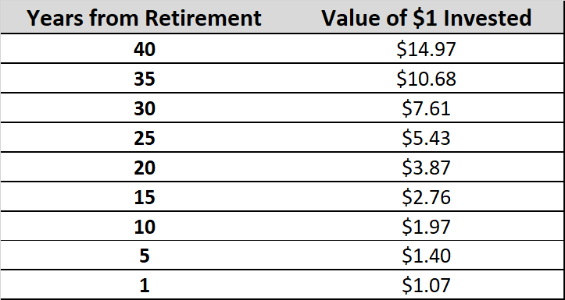
Start Early
*assuming a 7% annual ROI
Notes:
-Contribute up to employer match!

Slide 13
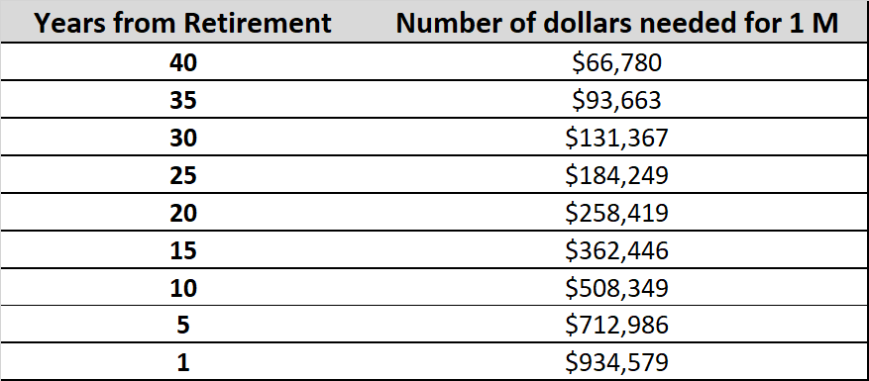
Start Early
Given a 7% annual return
Notes:
-Contribute up to employer match!

Slide 14
Hypothetical pre tax income – 3% portfolio withdrawal
Notes:
-Contribute up to employer match!

Slide 15
STOCKS
Fraction of ownership of a company
High risk, high upside
Tool for wealth building
The overall market returns about 7% annually on average
Notes:
-roth is post-tax contribution, traditional is pre-tax contribution
-used instead of 401k or to supplement it. (also social security)
-talk about differences in pre and post tax contribution
---The basic difference is that with pre-tax contributions (Traditional), you pay the tax on your contributions and the earnings when you withdraw them while with Roth contributions, you pay the tax on the contributions now but their earnings can be withdrawn tax free.
---The conventional approach is to compare your current tax bracket with what you think it will be in retirement, which would depend on your taxable income and the tax rates in place when you retire. If you expect it to be lower, go with pre-tax contributions. If you expect it to be higher, go with the Roth. **This can be more complex than this, but this is a general rule
-Roth: pay taxes now, not later
-Traditional: pay taxes later, not now

Slide 16
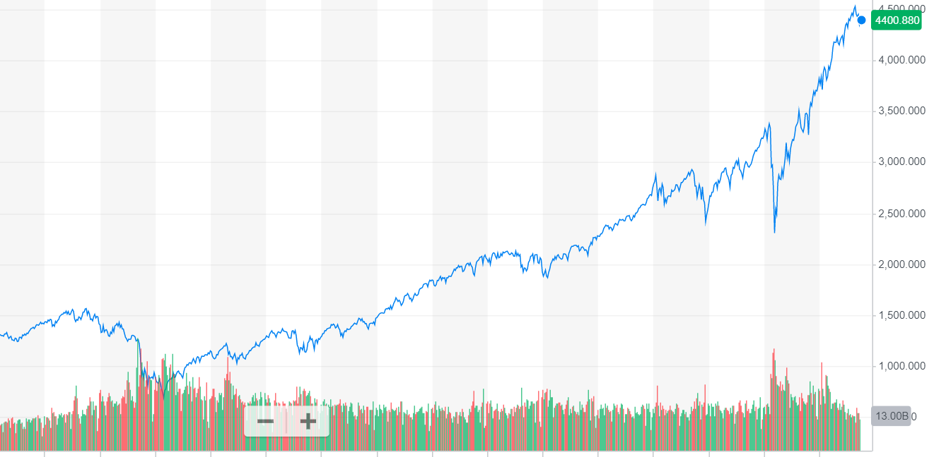
Notes:
-Savings accounts are with banks/credit unions
-CDs are illiquid with a set maturity and rate of return (sacrifice liquidity for higher return)
-Bonds are debt (when you own bonds you own a government’s or corporation’s debt); Lower payoff– on AVERAGE ← this is a key distinction
-Stocks: Higher risk; can be higher reward; A type of security that signifies ownership in a corporation and represents a claim on part of the corporation's assets and earnings.

Slide 17
BONDS
Investors act as lenders, loaning money to organizations in exchange for interest
Bonds can be issued by corporations or governments
Considered a less risky investment - who you’re borrowing money from matters
Consider the opportunity cost
Notes:
-Savings accounts are with banks/credit unions
-CDs are illiquid with a set maturity and rate of return (sacrifice liquidity for higher return)
-Bonds are debt (when you own bonds you own a government’s or corporation’s debt); Lower payoff– on AVERAGE ← this is a key distinction
-Stocks: Higher risk; can be higher reward; A type of security that signifies ownership in a corporation and represents a claim on part of the corporation's assets and earnings.

Slide 18
Mutual Fund
Mutual funds are investments that pool your money together with other investors to purchase shares of a collection of stocks, bonds, or other securities, referred to as a portfolio, that might be difficult to recreate on your own. Mutual funds are typically overseen by a portfolio manager.
Fidelity Learning Center
Notes:
-Savings accounts are with banks/credit unions
-CDs are illiquid with a set maturity and rate of return (sacrifice liquidity for higher return)
-Bonds are debt (when you own bonds you own a government’s or corporation’s debt); Lower payoff– on AVERAGE ← this is a key distinction
-Stocks: Higher risk; can be higher reward; A type of security that signifies ownership in a corporation and represents a claim on part of the corporation's assets and earnings.

Slide 19
Diversification Matters
Mutual Funds
Index Funds
Exchange Traded Fund (ETF)
Notes:
-Savings accounts are with banks/credit unions
-CDs are illiquid with a set maturity and rate of return (sacrifice liquidity for higher return)
-Bonds are debt (when you own bonds you own a government’s or corporation’s debt); Lower payoff– on AVERAGE ← this is a key distinction
-Stocks: Higher risk; can be higher reward; A type of security that signifies ownership in a corporation and represents a claim on part of the corporation's assets and earnings.

Slide 20
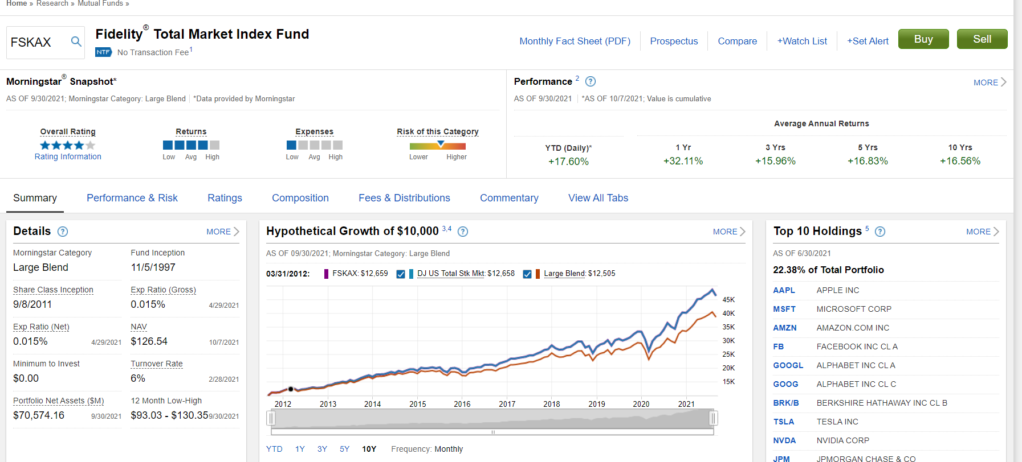
Notes:
-Savings accounts are with banks/credit unions
-CDs are illiquid with a set maturity and rate of return (sacrifice liquidity for higher return)
-Bonds are debt (when you own bonds you own a government’s or corporation’s debt); Lower payoff– on AVERAGE ← this is a key distinction
-Stocks: Higher risk; can be higher reward; A type of security that signifies ownership in a corporation and represents a claim on part of the corporation's assets and earnings.

Slide 21
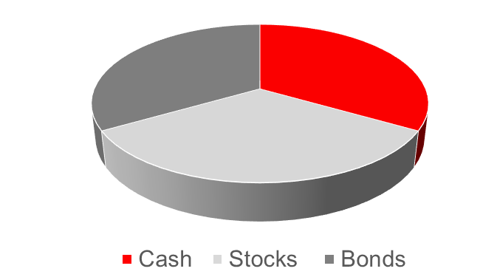
Asset Allocation
“Asset allocation is critically important: but cost is critically important too … all other factors pale in comparison” – Jack Bogle, Founder – Vanguard Group
Notes:
-Savings accounts are with banks/credit unions
-CDs are illiquid with a set maturity and rate of return (sacrifice liquidity for higher return)
-Bonds are debt (when you own bonds you own a government’s or corporation’s debt); Lower payoff– on AVERAGE ← this is a key distinction
-Stocks: Higher risk; can be higher reward; A type of security that signifies ownership in a corporation and represents a claim on part of the corporation's assets and earnings.

Slide 22
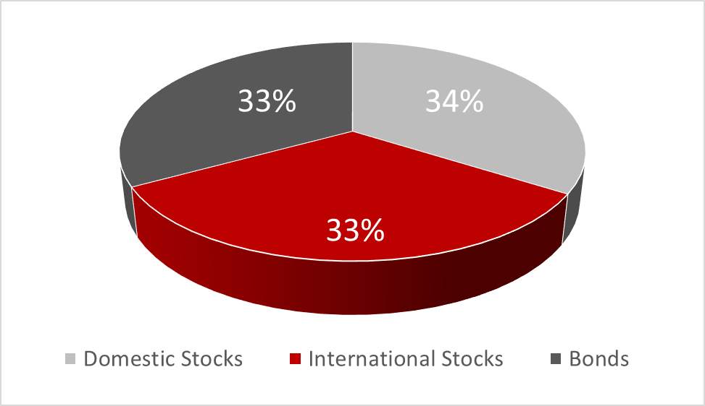
Sample Portfolio 1
Equal parts international stock, domestic stock, and bonds
Notes:
-Savings accounts are with banks/credit unions
-CDs are illiquid with a set maturity and rate of return (sacrifice liquidity for higher return)
-Bonds are debt (when you own bonds you own a government’s or corporation’s debt); Lower payoff– on AVERAGE ← this is a key distinction
-Stocks: Higher risk; can be higher reward; A type of security that signifies ownership in a corporation and represents a claim on part of the corporation's assets and earnings.

Slide 23
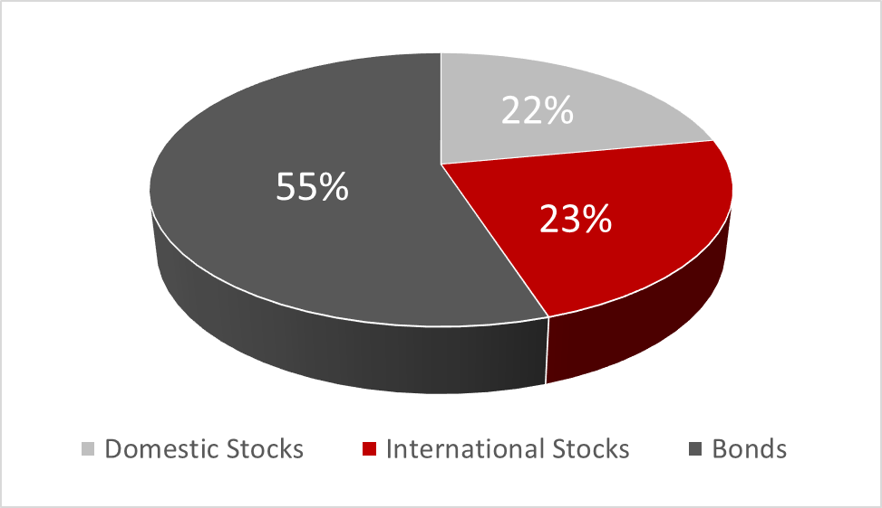
Sample Portfolio 2
55 year old, less aggressive portfolio
Owns age in bonds
Notes:
-Savings accounts are with banks/credit unions
-CDs are illiquid with a set maturity and rate of return (sacrifice liquidity for higher return)
-Bonds are debt (when you own bonds you own a government’s or corporation’s debt); Lower payoff– on AVERAGE ← this is a key distinction
-Stocks: Higher risk; can be higher reward; A type of security that signifies ownership in a corporation and represents a claim on part of the corporation's assets and earnings.

Slide 24
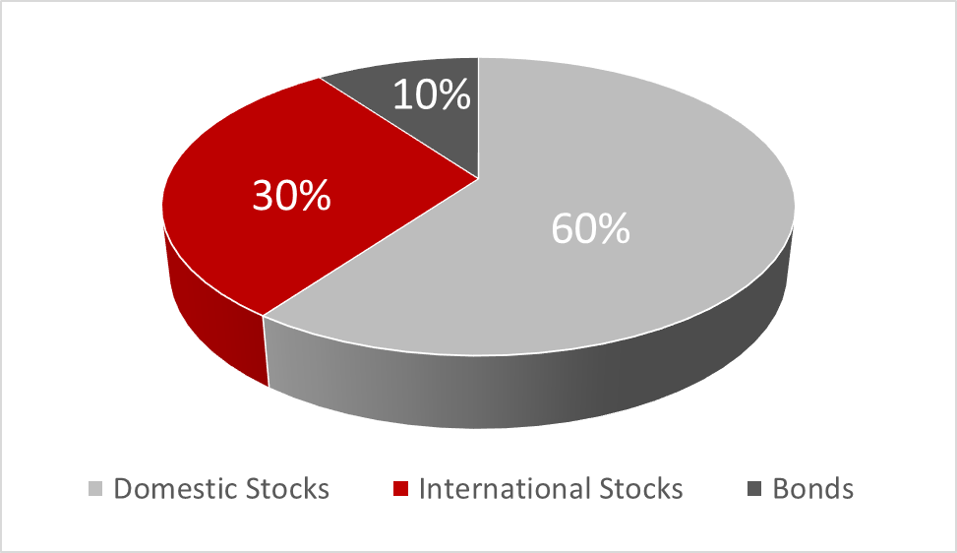
Sample Portfolio 3
Very aggressive portfolio
Notes:
-Savings accounts are with banks/credit unions
-CDs are illiquid with a set maturity and rate of return (sacrifice liquidity for higher return)
-Bonds are debt (when you own bonds you own a government’s or corporation’s debt); Lower payoff– on AVERAGE ← this is a key distinction
-Stocks: Higher risk; can be higher reward; A type of security that signifies ownership in a corporation and represents a claim on part of the corporation's assets and earnings.

Slide 25
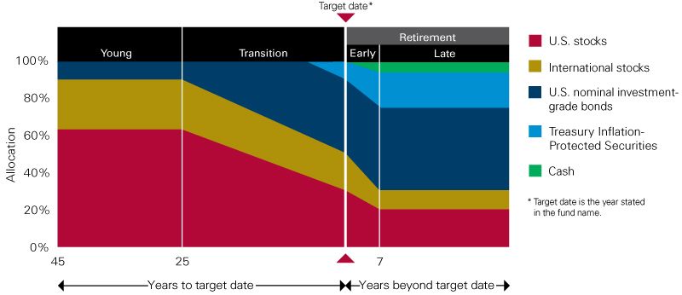
Notes:
-Savings accounts are with banks/credit unions
-CDs are illiquid with a set maturity and rate of return (sacrifice liquidity for higher return)
-Bonds are debt (when you own bonds you own a government’s or corporation’s debt); Lower payoff– on AVERAGE ← this is a key distinction
-Stocks: Higher risk; can be higher reward; A type of security that signifies ownership in a corporation and represents a claim on part of the corporation's assets and earnings.

Slide 26
Your options at OSU
Notes:
WHAT IS IT? WHY USE IT?
*Can ask audience if they know what it represents, why it matters

Slide 27
Key Concept 1 – Defined Contribution vs Defined Benefit
In a defined benefit plan, employers offer a fixed, pre-established benefit for employees at retirement. Often, the benefit is based on factors such as the participant’s salary, age and the number of years he or she worked for the employer.
In a defined contribution plan, employee and/or the employer contribute to the employee’s individual account under the plan. The amount in the account at distribution includes the contributions and investment gains or losses, minus any investment and administrative fees.
Notes:
-Contribute up to employer match!

Slide 28
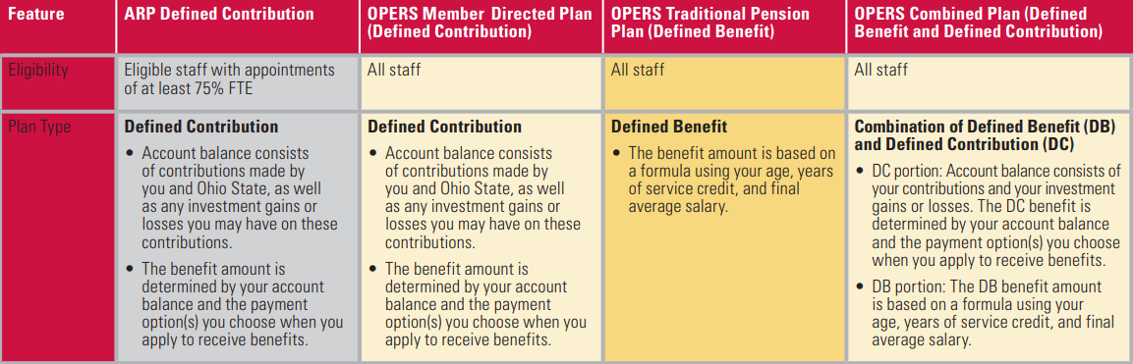
Notes:
-Contribute up to employer match!

Slide 29
Key Concept 2 – Employee Contribution
What % of your pay is contributed to a pension or other account
      10% in all situations
Pretax – reduction in taxable income today – taxed like income in retirement
Notes:
-Contribute up to employer match!

Slide 30
Key Concept 3 – Employer Contribution
What your employer contributes to your retirement savings
Not taxable income, but taxable upon withdrawal at retirement age
Variable Based on the plan you choose
Notes:
-Contribute up to employer match!

Slide 31
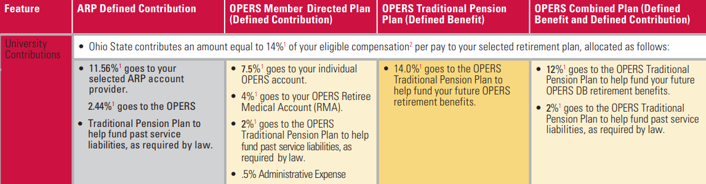
Notes:
WHAT IS IT? WHY USE IT?
*Can ask audience if they know what it represents, why it matters

Slide 32
Key Concept 4 – Vesting Period
In short, when the employer’s contribution becomes yours
Your contributions vest immediately
How does this work with your career plans?
Notes:
-Contribute up to employer match!

Slide 33
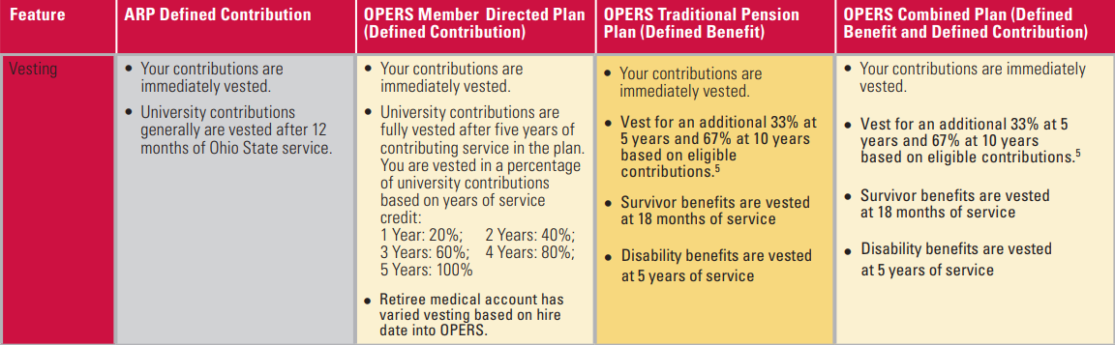
Notes:
WHAT IS IT? WHY USE IT?
*Can ask audience if they know what it represents, why it matters

Slide 34
ARP – 401(a)
Tax deferred, self managed investment account
Highly flexible, portable retirement account
Pre-tax, only taxed at retirement after 59.5
2.44% mitigating rate
Notes:
-Contribute up to employer match!

Slide 35
Considerations ARP – 401(a)
Your willingness and comfort in selecting investments
Comfort with market risk
Notes:
-Contribute up to employer match!

Slide 36
Investment Elections - ARP
Tier 1: Vanguard Target Retirement Fund
Tier 2: Build Your Own
Tier 3: Self-directed Brokerage
Notes:
-Contribute up to employer match!

Slide 37
OPERS Member Directed Plan
Similar to a 401(a) – you choose investments
Benefit rate is determined by expenses, account gains and losses, retirement age and OPERS formula.
Notes:
-Contribute up to employer match!

Slide 38
OPERS Member Directed Plan
Choose from:
Six OPERS index funds
10 OPERS target date funds
Self-Directed Brokerage Account
Notes:
-Contribute up to employer match!

Slide 39
Considerations - Member Directed Plan
Comfort with market risk, choosing investments
Relatively limited investment options
Could result in higher income at retirement
Still allows contribution to retiree medical fund
Longer vesting period than ARP
Notes:
-Contribute up to employer match!

Slide 40
OPERS Traditional Pension Plan
Final benefit amount based on formula including age, years of service, and final average salary
Not very portable
Your contribution grows by years of “service credit” towards retirement age
Notes:
-Contribute up to employer match!

Slide 41
Considerations - Traditional Pension Plan
Very safe, hands off system – insulation from market risk
Particularly if starting young, ARP could yield more income at retirement
Longest vesting period – fully vested at 10 years
Notes:
-Contribute up to employer match!

Slide 42
OPERS Combined Plan
Your employer’s contributions are managed by OPERS
Your contribution are managed by you
  Same options as Member Directed Plan
  2% mitigating rate
  The employer contribution earns service credits
Notes:
-Contribute up to employer match!

Slide 43
Considerations – Combined Plan
Particularly if starting young, ARP could yield more income at retirement
Longest vesting period – fully vested at 10 years
Not wholly insulated from market risk
Notes:
-Contribute up to employer match!

Slide 44
After Ohio State

Slide 45
After Ohio State – MD, ARP & Combined Plan
Leave vested balance alone to grow
Roll into new employer’s 401(k) or IRA
Take it out – expect to pay taxes and a penalty
Take it out - in the form of an annuity
Notes:
-Savings accounts are with banks/credit unions
-CDs are illiquid with a set maturity and rate of return (sacrifice liquidity for higher return)
-Bonds are debt (when you own bonds you own a government’s or corporation’s debt); Lower payoff– on AVERAGE ← this is a key distinction
-Stocks: Higher risk; can be higher reward; A type of security that signifies ownership in a corporation and represents a claim on part of the corporation's assets and earnings.

Slide 46
OPERS – Pension
Leave vested balance alone to grow
Take partial pension based on your service years and average salary and age
Roll into a new pension system(?!)
Don’t undervalue your service credits***
Notes:
-Savings accounts are with banks/credit unions
-CDs are illiquid with a set maturity and rate of return (sacrifice liquidity for higher return)
-Bonds are debt (when you own bonds you own a government’s or corporation’s debt); Lower payoff– on AVERAGE ← this is a key distinction
-Stocks: Higher risk; can be higher reward; A type of security that signifies ownership in a corporation and represents a claim on part of the corporation's assets and earnings.

Slide 47
International Considerations
The money is yours, but the tax liability doesn’t leave the country with you
Can you manage the investment abroad?
A financial planner may be able to help
Notes:
-Savings accounts are with banks/credit unions
-CDs are illiquid with a set maturity and rate of return (sacrifice liquidity for higher return)
-Bonds are debt (when you own bonds you own a government’s or corporation’s debt); Lower payoff– on AVERAGE ← this is a key distinction
-Stocks: Higher risk; can be higher reward; A type of security that signifies ownership in a corporation and represents a claim on part of the corporation's assets and earnings.

Slide 48
Ben Raines, Program Coordinator
Raines.56@osu.edu
FREE ● CONFIDENTIAL ● FOR EVERYONE
Student Wellness Center - RPAC
go.osu.edu/yourfinances
@SGFOSU
Notes:
Questions?

