Slide 1
BIOSIMILARS
Nick Conty

Slide 2
Objectives
Understand the purpose of a biosimilar and its place in therapy
Recognize market share of biologics and biosimilars
Identity benefits of biosimilars and challenges to becoming approved

Slide 3
Background
Biologics – Drugs from a natural source¹
      Humans, animals, microorganisms
Biosimilar – Highly similar drug to currently approved biologic¹
      No clinically meaningful difference from reference product
      Same efficacy and safety profile
      Associated with lower development costs
Biosimilar approval
      Biologics Price Competition and Innovation Act (BPCIA)
      351(k) application requires fewer clinical trials than reference product

Slide 4
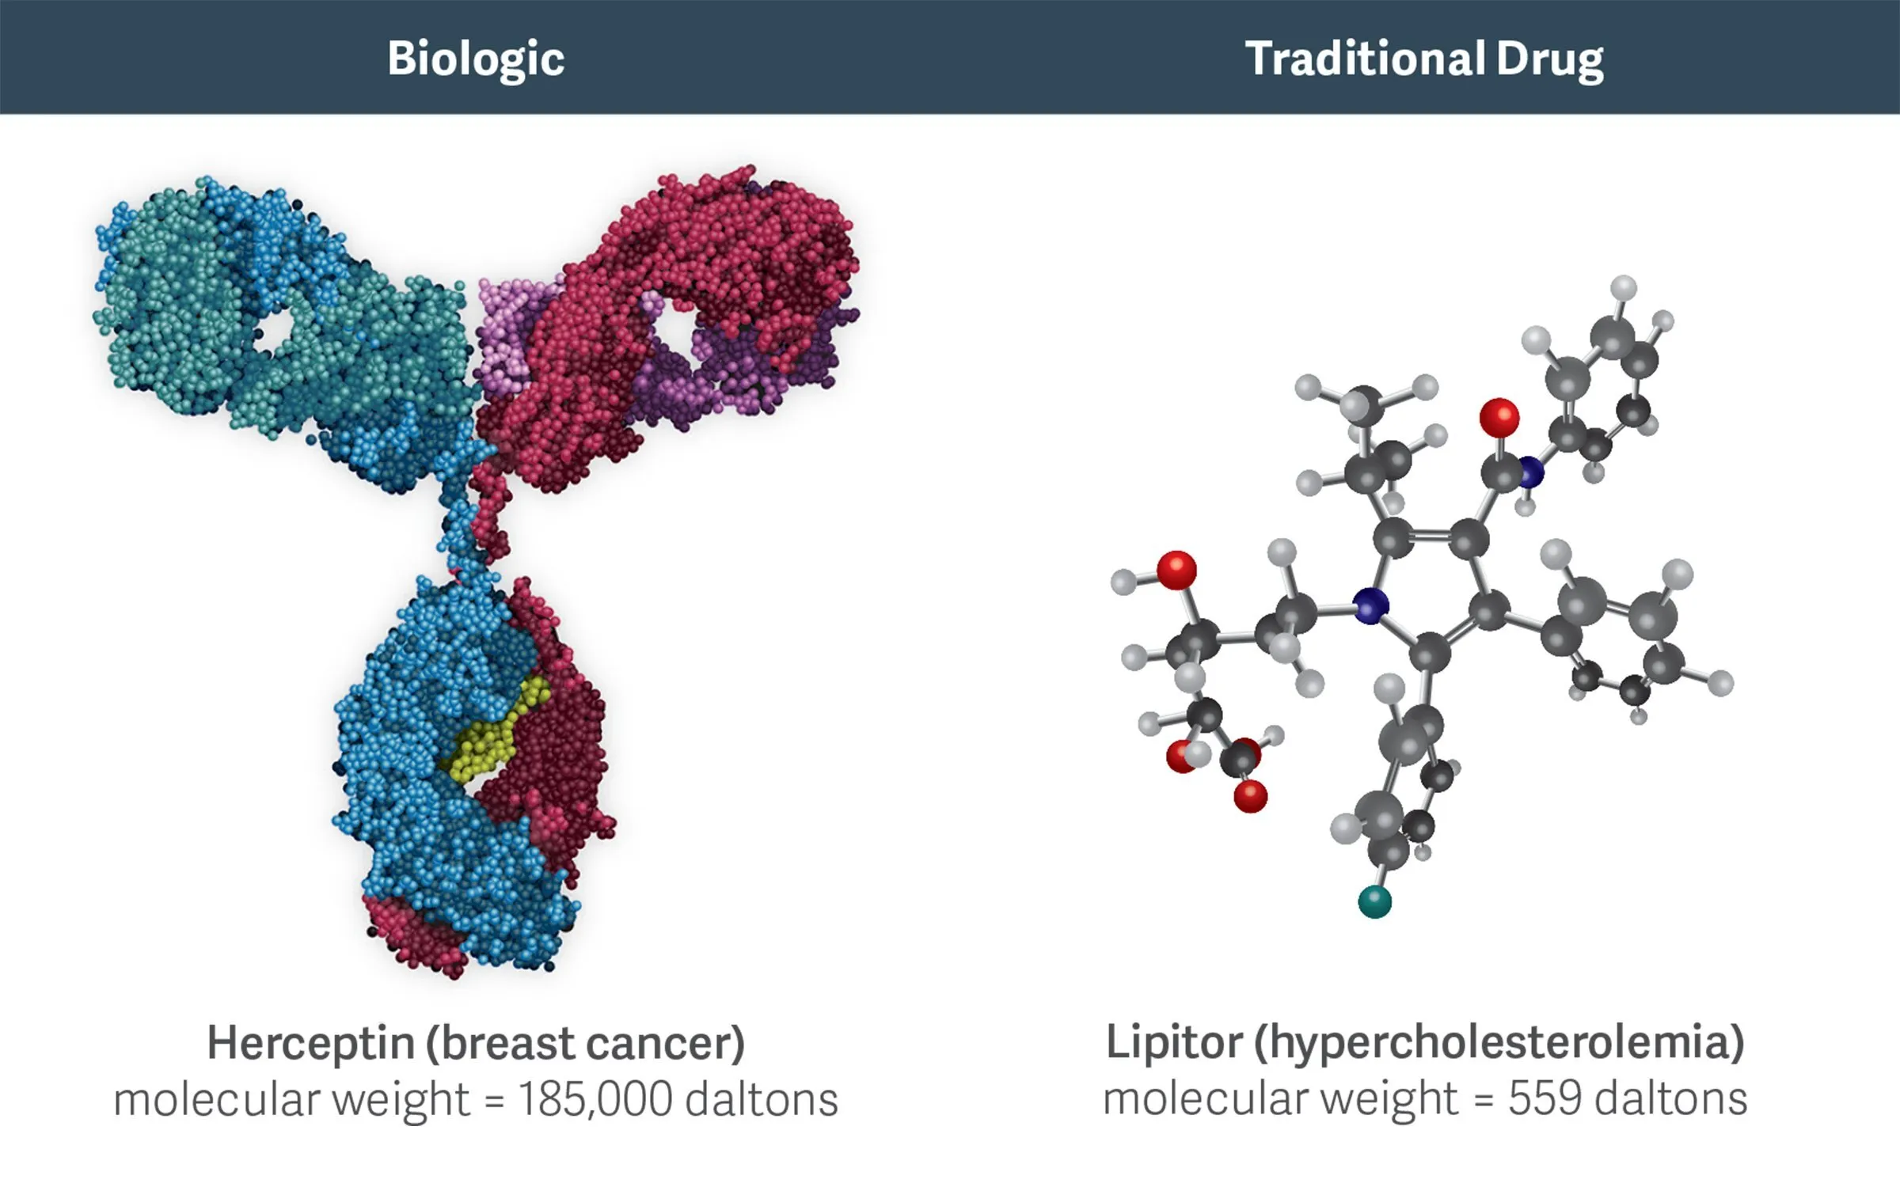
Biosimilars vs Generics

Slide 5
History
First Biosimilar approved was in Europe³
      2006 – Omnitrope (somatropin)
First Biosimilars in the US
      2015 – Filgrastim (Zarxio)
      2016 – Infliximab (Inflectra)
93 biosimilars currently approved in Europe
41 biosimilars approved in the US from 11 different reference products

Slide 6
Biosimilar Market
Biologics make up about 2% of prescriptions but 40% of spending
Biosimilar global market valued at $25.2 billion in 2022
      Europe accounts for over 50% of market value but North America is the fastest growing region
      Expected to be $126 billion by 2027-2032
Monoclonal antibodies made up 40.91% of revenue
Oncology medications made up 24.29%⁵

Slide 7
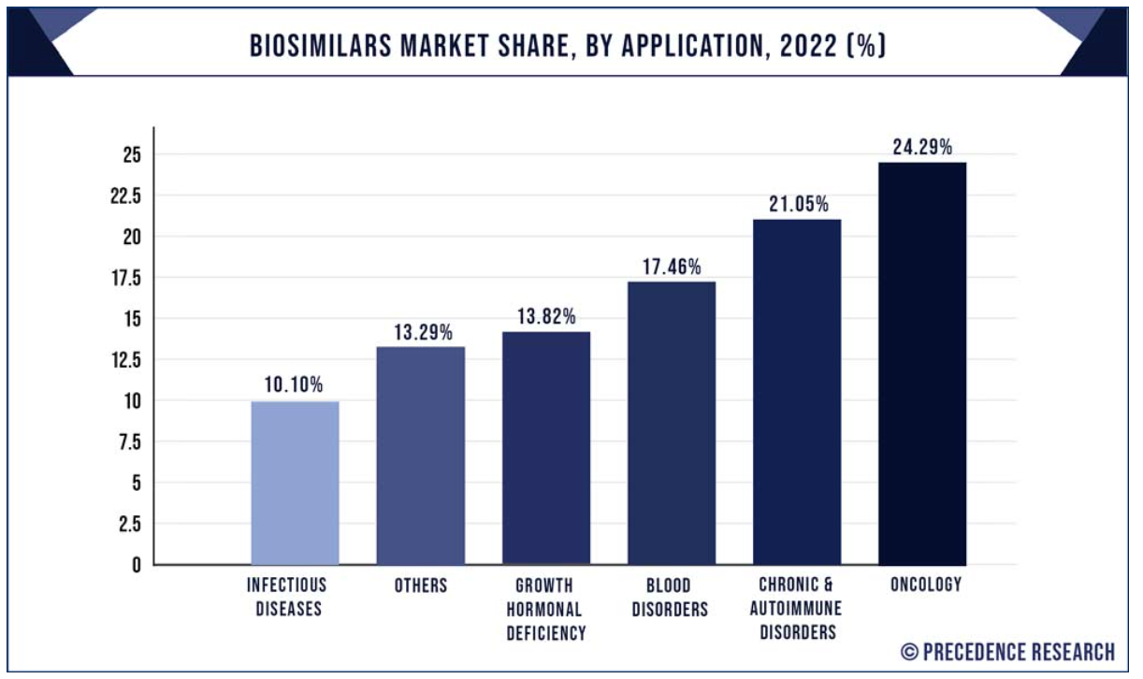
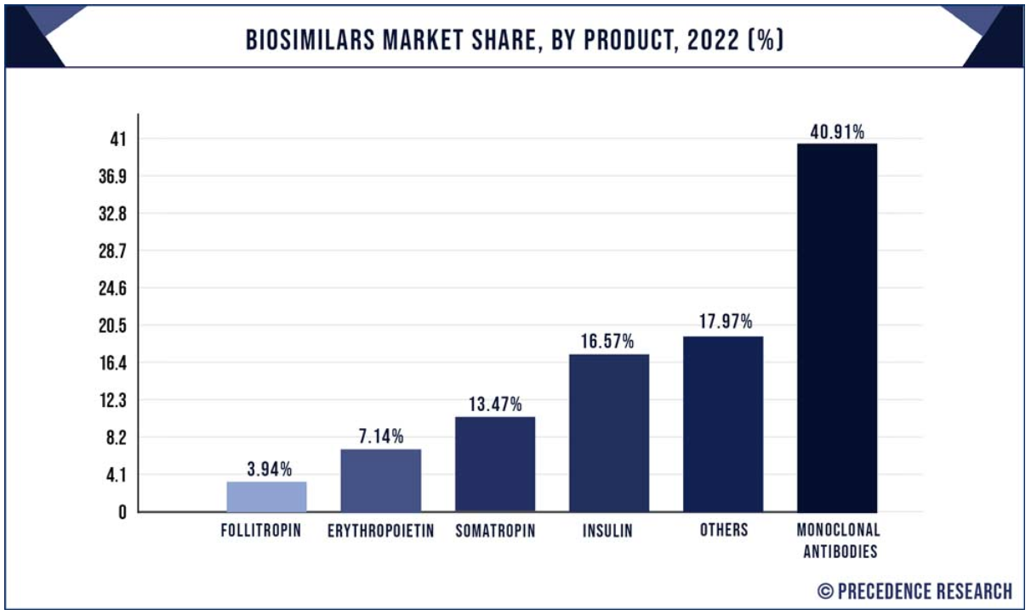
Biosimilar Market
Notes:
Biosimilars Market (by product: Monoclonal antibodies, glucagon, insulin, erythropoietin, interferon, and calcitonin; application: Oncology, growth hormonal deficiency, blood disorders, chronic & autoimmune disorders, and others) - global industry analysis, size, share, growth, trends, regional outlook, and forecast 2023 - 2032. Precedence Research. Accessed June 27, 2023. https://www.precedenceresearch.com/biosimilars-market#:~:text=According%20to%20Precedence%20Research%2C%20the,USD%20126.01%20billion%20by%202032.

Slide 8
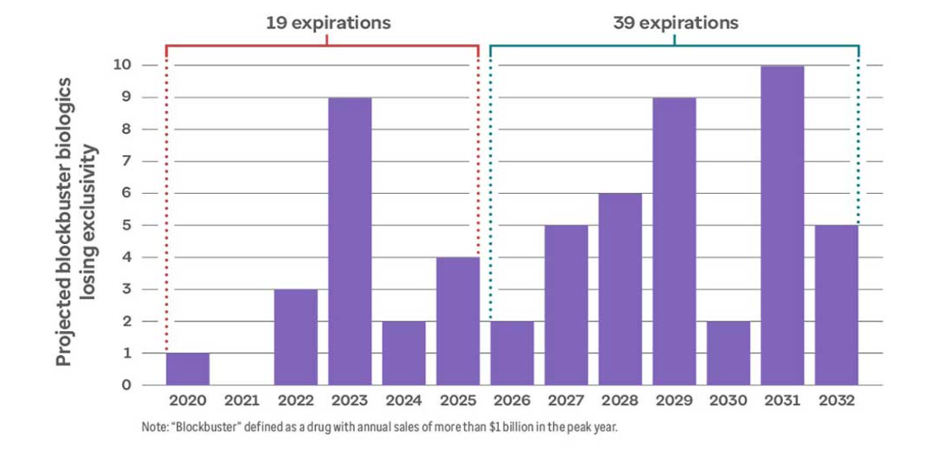
Rest of the Decade
2023 – Humira (AbbVie)
2024 – Eylea (Regeneron and Bayer)
2025 – Stelara (Johnson & Johnson)
2028 – Keytruda (Merck)
2028 – Opdivo (BMS)⁶
Notes:
1. Biosimilars to save billions in this decade. Optum. Accessed June 28, 2023. https://www.optum.com/business/insights/pharmacy-care-services/page.hub.biosimilar-savings.html#:~:text=Dozens%20of%20high%2Dcost%20biologic,should%20also%20lose%20patent%20protection.

Slide 9
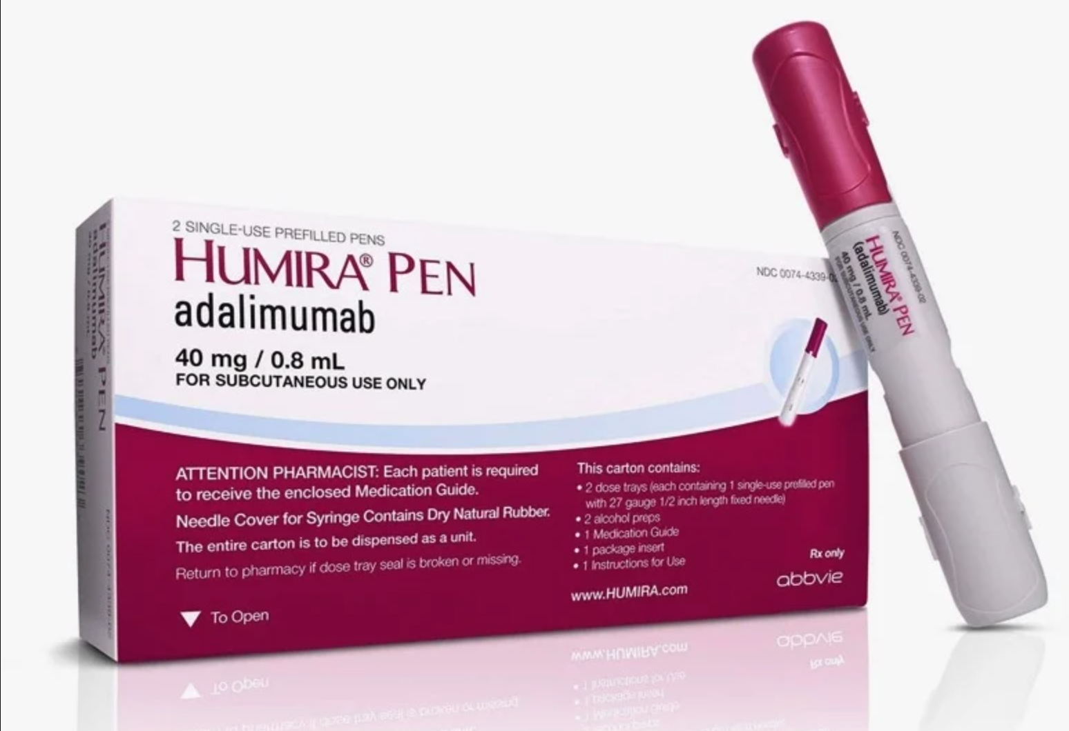
Humira
2022 Revenue: $18 billion
More than 300,000 U.S.
patients are treated⁷
9 FDA approved biosimilars launching in 2023⁸
Amjevita projected revenue 2023: $748 million⁹
Yusimry -$13k per year (Humira – $90k)⁷

Slide 10
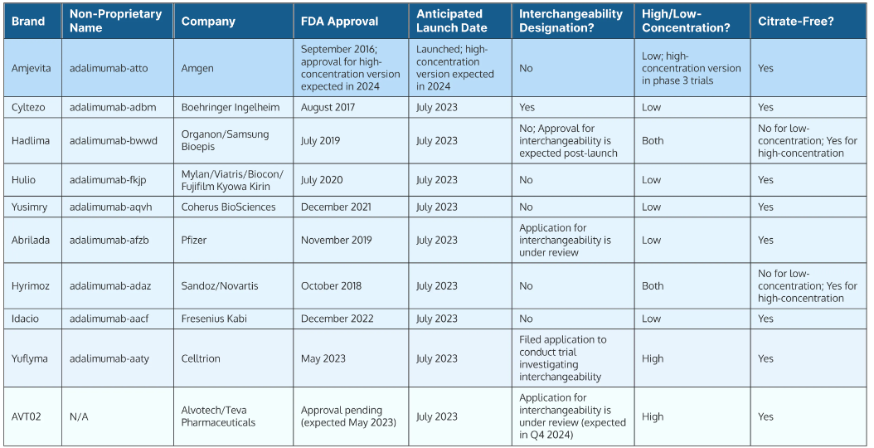
Humira Biosimilars
Notes:
1. Jeremias S. FDA approves Celltrion’s Yuflyma, the ninth adalimumab biosimilar. Center for Biosimilars. May 26, 2023. Accessed June 28, 2023. https://www.centerforbiosimilars.com/view/fda-approves-celltrion-s-yuflyma-the-ninth-adalimumab-biosimilar.

Slide 11
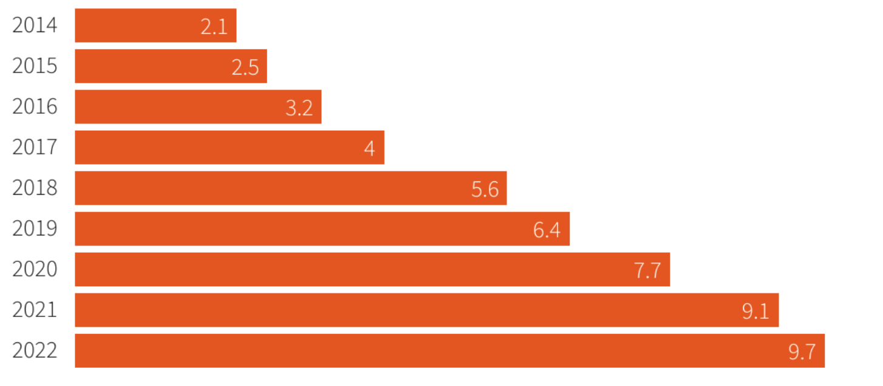
Stelara
2022 revenue: $9.7 billion
      J&J’s top selling drug
Projected 2025 revenue: $5.4 billion
2 Biosimilars under FDA review
  Settlements to delay availability
      Alvotech– February 21, 2025
      Amgen – January 1, 2025
Notes:
Wingrove P. Analysis: Stelara Patent deal puts J&J back on path to $57 billion 2025 revenue forecast. Reuters. June 5, 2023. Accessed June 27, 2023. https://www.reuters.com/business/healthcare-pharmaceuticals/stelara-patent-deal-puts-jj-back-path-57-bln-2025-revenue-forecast-2023-06-05/.

Slide 12
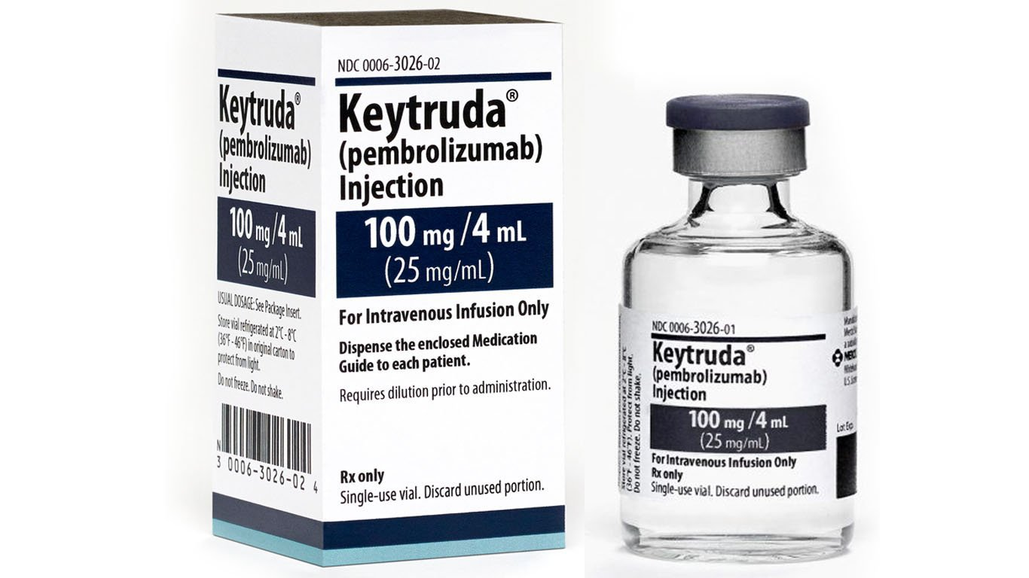
Keytruda
2022 revenue: $20.9 billion¹¹
Patents through 2028¹²
      Merck has trials for subcutaneous injection
      Patent extension beyond 2028 if approved
Infusion list price: $185k per year
4 biosimilars in the pipeline as of 2022
      BioXpress Therapeutics
      DM Bio
      Formycon
      Neuclone/Serum Institute of India

Slide 13
Benefits of Biosimilars
Biologic market competition
Reduction in healthcare costs
      Estimated reduction of biologic spending by $54 billion from 2017-2026 (3% of total biologic spending)¹³
Incentives for healthcare systems
      Kaiser Permanente had 97% uptake of bevacizumab biosimilar just 1 month after launch
      By November 2019, $200 million in savings¹⁴
Increased options for patients
      Easier access to biologic or biosimilar medications
      Reduced copays or coinsurances

Slide 14
Challenges to Biosimilar Use
PBMs receiving better rebates for reference product
Legal disputes
      Reference product manufacturers will submit patents to delay biosimilar approval
Barriers to Biosimilars making it to market²
      Regulatory exclusivity
      Interchangeability requirements
      Patent exclusivity

Slide 15
Challenges to Biosimilar Use cont.
Physician and patient hesitation to therapy disruption
      2019 survey: 84% of US physicians were opposed to switching a stable patient on a reference product
      85% of patients were concerned biosimilars not treating as well as the reference product¹⁶
      2023 survey found 77% of physicians still hesitant to switch from reference product to biosimilar¹⁸
Lesser-known Manufacturers

Slide 16
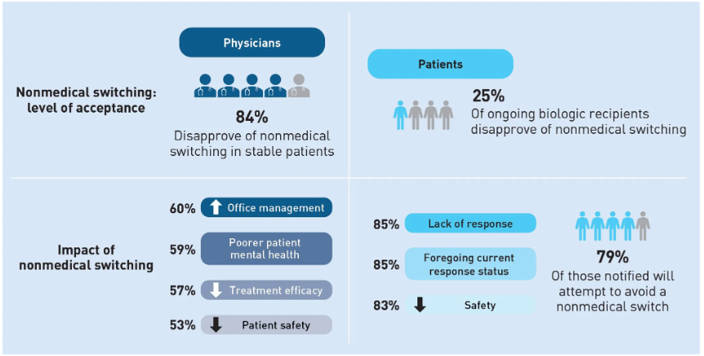
Challenges to Biosimilar Use cont.
Notes:
1. Gibofsky A, Evans C. Provider and patient knowledge gaps on biosimilars: Insights from surveys. AJMC. November 1, 2022. Accessed June 27, 2023. https://www.ajmc.com/view/biosimilarssuppl-insightssurveys.

Slide 17
Moving Forward
Interchangeability
      Displaying biosimilar is highly similar to reference product: clinical effectiveness, toxicity, immunogenicity, pharmacokinetics, pharmacodynamics¹⁵
Provider and patient education
Expanded formulary to include biosimilars
Biosimilar placement on higher tiers than reference biologics
Greater reimbursement through rebates

Slide 18
Center for Drug Evaluation and Research. Biosimilar Basics for patients. U.S. Food and Drug Administration. Accessed June 23, 2023. https://www.fda.gov/drugs/biosimilars/biosimilar-basics-patients.
Goli VAR, Butreddy A. Biosimilar monoclonal antibodies: Challenges and approaches towards formulation. Chem Biol Interact. 2022;366:110116. doi:10.1016/j.cbi.2022.110116
Biosimilars approved in Europe. GaBi Online. May 12, 2023. Accessed June 23, 2023. https://www.gabionline.net/biosimilars/general/biosimilars-approved-in-europe#:~:text=EMA%20first%20developed%20guidelines%20for,biosimilar%20in%202006%20%5B2%5D.
Kvien TK, Patel K, Strand V. The cost savings of biosimilars can help increase patient access and lift the financial burden of health care systems. Semin Arthritis Rheum. 2022;52:151939. doi:10.1016/j.semarthrit.2021.11.009
Biosimilars Market (by product: Monoclonal antibodies, glucagon, insulin, erythropoietin, interferon, and calcitonin; application: Oncology, growth hormonal deficiency, blood disorders, chronic & autoimmune disorders, and others) - global industry analysis, size, share, growth, trends, regional outlook, and forecast 2023 - 2032. Precedence Research. Accessed June 27, 2023. https://www.precedenceresearch.com/biosimilars-market#:~:text=According%20to%20Precedence%20Research%2C%20the,USD%20126.01%20billion%20by%202032.
Higgins-Dunn N. The top 15 blockbuster patent expirations coming this decade. Fierce Pharma. July 12, 2021. Accessed June 27, 2023. https://www.fiercepharma.com/special-report/top-15-blockbuster-patent-expirations-coming-decade.
Blank C. Coherus announces lowest price for Humira biosimilar, partners with Mark Cuban Cost Plus. Formulary Watch. June 2, 2023. Accessed June 27, 2023. https://www.formularywatch.com/view/coherus-announces-lowest-price-for-humira-biosimilar-partners-with-mark-cuban-cost-plus.
Wingrove P. AbbVie’s Humira gets a U.S. rival, but costs could stay high. Reuters. February 1, 2023. Accessed June 27, 2023. https://www.reuters.com/business/healthcare-pharmaceuticals/abbvies-humira-gets-us-rival-costs-could-stay-high-2023-01-31/.
Billingsley A. Humira biosimilar boom: 9 meds coming in 2023 and beyond - goodrx. GoodRx Health. June 8, 2023. Accessed June 27, 2023. https://www.goodrx.com/humira/biosimilars.
Wingrove P. Analysis: Stelara Patent deal puts J&J back on path to $57 billion 2025 revenue forecast. Reuters. June 5, 2023. Accessed June 27, 2023. https://www.reuters.com/business/healthcare-pharmaceuticals/stelara-patent-deal-puts-jj-back-path-57-bln-2025-revenue-forecast-2023-06-05/.
Merck announces fourth-quarter and full-year 2022 financial results. Merck.com. February 23, 2023. Accessed June 27, 2023. https://www.merck.com/news/merck-announces-fourth-quarter-and-full-year-2022-financial-results/.
Erman M. Merck could keep its patent edge by shifting Keytruda cancer drug to a simple shot. Reuters. December 2, 2022. Accessed June 27, 2023. https://www.reuters.com/business/healthcare-pharmaceuticals/merck-could-keep-its-patent-edge-by-shifting-keytruda-cancer-drug-simple-shot-2022-12-02/.
Mulcahy, Andrew W., Jakub P. Hlavka, and Spencer R. Case, Biosimilar Cost Savings in the United States: Initial Experience and Future Potential. Santa Monica, CA: RAND Corporation, 2017. https://www-rand-org.proxy.lib.ohio-state.edu/pubs/perspectives/PE264.html.
Kvien TK, Patel K, Strand V. The cost savings of biosimilars can help increase patient access and lift the financial burden of health care systems. Semin Arthritis Rheum. 2022;52:151939. doi:10.1016/j.semarthrit.2021.11.009
Goli VAR, Butreddy A. Biosimilar monoclonal antibodies: Challenges and approaches towards formulation. Chem Biol Interact. 2022;366:110116. doi:10.1016/j.cbi.2022.110116
1. Gibofsky A, Evans C. Provider and patient knowledge gaps on biosimilars: Insights from surveys. AJMC. November 1, 2022. Accessed June 27, 2023. https://www.ajmc.com/view/biosimilarssuppl-insightssurveys.
Hagen T. CMS payment policy plays role in biosimilar uptake. Center for Biosimilars. December 19, 2020. Accessed June 27, 2023. https://www.centerforbiosimilars.com/view/cms-payment-policy-plays-role-in-biosimilar-uptake.
1. Dunleavy K. Years after the first US biosim launches, doctors still have their concerns: Survey. Fierce Pharma. February 16, 2023. Accessed June 28, 2023. https://www.fiercepharma.com/pharma/physicians-not-board-biosimilars-sermo-survey-says#:~:text=Doctors’%20views%20on%20biosimilars%20haven,medical%20switch%20to%20a%20biosimilar.

