Slide 1
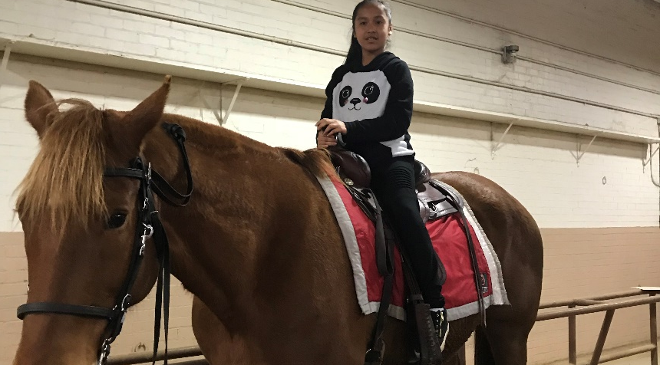
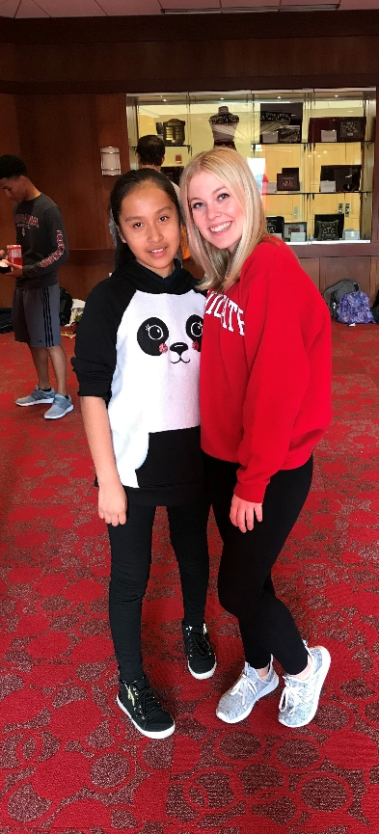
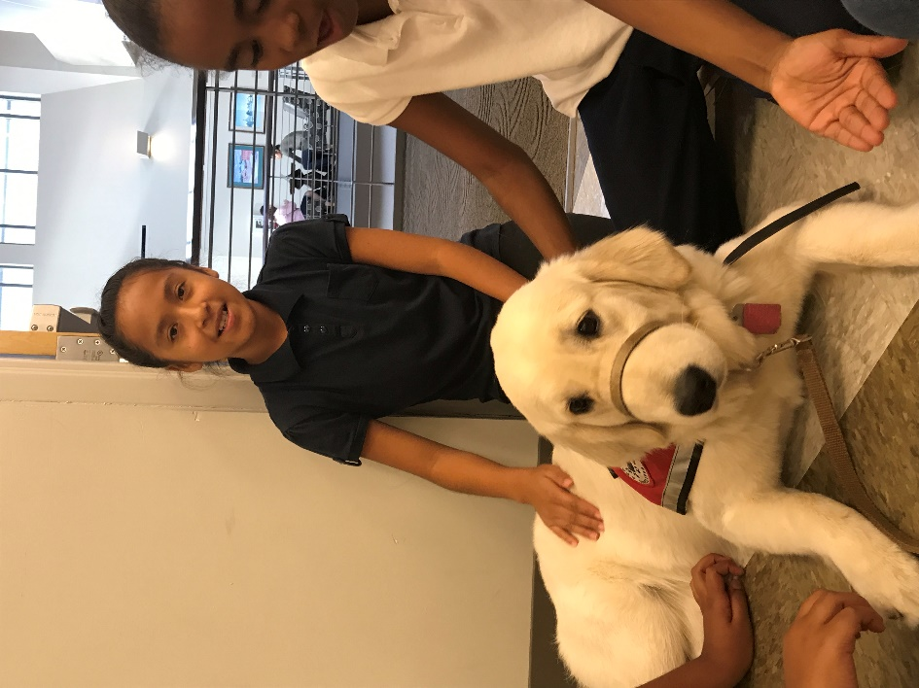
COLLEGE MENTORS FOR KIDS
Michaela Schlegel
Serve as a role model for one child (1st – 5th grade) in the greater Columbus area
Meet at Union with children once a week for 2 hours to take part in planned activities that promote higher education
Requirements: $85 fundraising goal each semester; required to ride the bus twice a semester
Contact info: (704)-491-3934 or cmfkosu.recruitment@gmail.com

