Slide 1
Academic Publishing and the Responsible Conduct of Research
Melanie Schlosser - University Libraries Jen Yucel - Office of Research Compliance

Slide 2
Agenda
Overview of the Office of Research
Overview of the University Libraries
Predatory Publishing
Research Misconduct & Plagiarism
Responsible Conduct of Research topics
Conflict of Interest

Slide 3
Organizational Structure
Office of Research

Slide 4
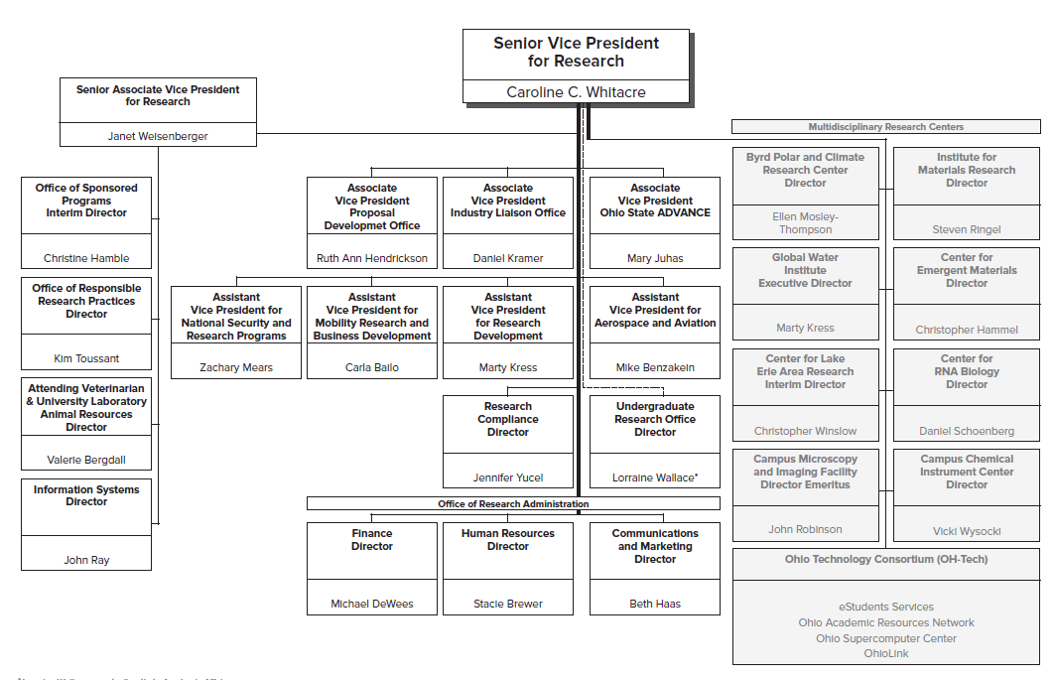
Sponsored Programs

Slide 5
Human /Animal Protocols

Slide 6
Animal Use / Vet Services

Slide 7
Research Compliance

Slide 9
OSU Libraries Resources

Slide 10
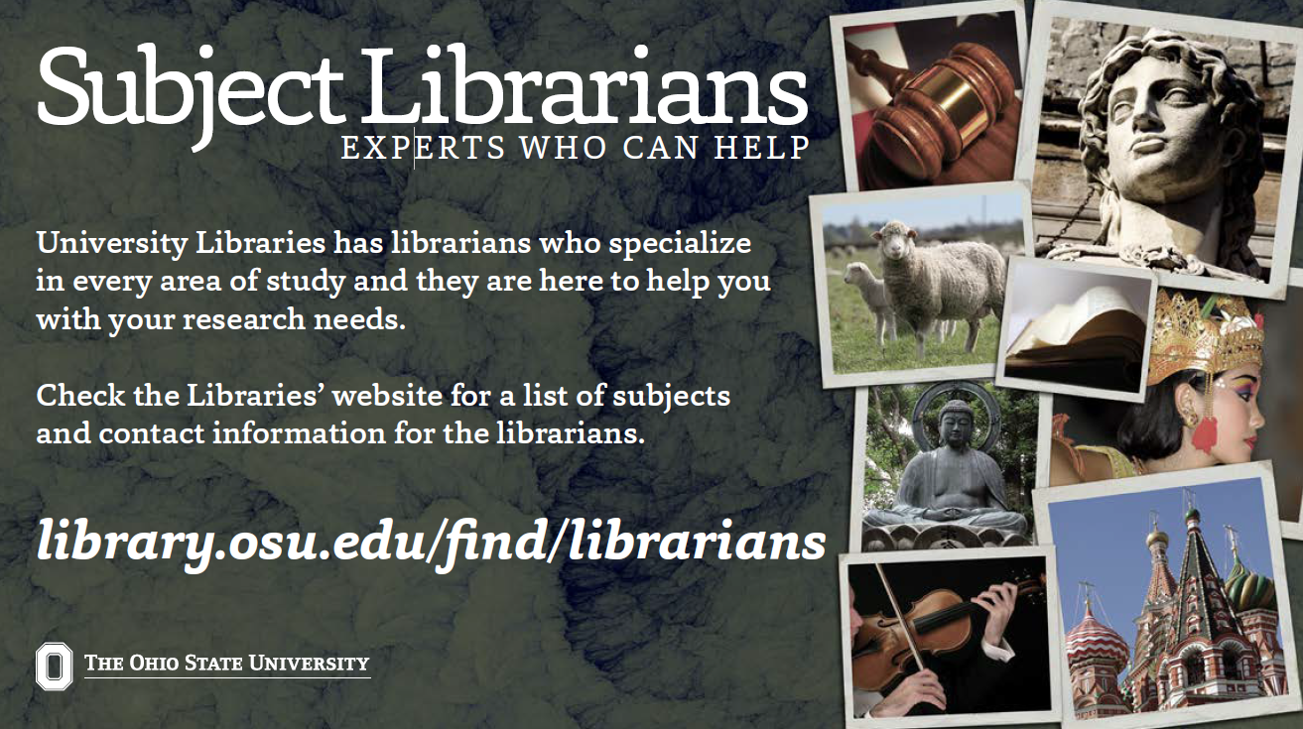
Resources

Slide 11
Resources
Research Commons
3rd floor 18th Avenue Library
https://library.osu.edu/researchcommons
Office Hours
Publishing and Repository Services
Copyright Resources Center
Data Management Plans
Funding Opportunities
Geographic Information Services(GIS)
IRB / Human Subjects Research
The Writing Center
Workshops
Publishing Basics
Finding Funding
IRB Submissions
Grant Writing Introduction
Data Management Basics and Data Management Plans
GIS for the Rest of US
Copyright and Fair Use

Slide 12
Predatory Publishing

Slide 13
Choosing a Journal
Access Models
Subscription Journals: Content is behind a paywall
Open Access (OA) Journals: Content is freely available
Hybrid Journals: Content is behind a paywall unless you pay an Open Access fee
TIP: Don’t pay for hybrid OA
Notes:
Access models – this could be meaningful to you for multiple reasons – what your institution has access to, campus mandates, personal feelings about access

Slide 14
The Problem with Lists
White lists (“good” journals)
Black lists (“bad” journals)
Any lists

Slide 15
Choosing a Journal
Advance-Fee Scams
Little or no published scholarship
Lack of a named editor or editorial board
Promises full peer review with very fast turnaround
Journal website doesn’t make sense
Search Google, ask around
Notes:
Because getting published is so important to a scholars career some scams have cropped up
These are often referred to as predatory journals - their goals are to make money. A scam often takes the form of getting an email asking you to publish, you submit, and they give you a large bill
a really good way to uncover these is to take a look at the journal websites – if they have articles read a few to gauge the quality
What is the problem with publishing these journals – beyond paying money for a poor product – you wont get the advantages of peer review, your work could disappear or be hard to find, or it could harm your reputation or prevent you from publishing that research in a legitimate and respectable journal
Mention that sometimes people are unwittingly placed on editorial boards – if it’s a name you recognize but the rest of the website seems fishy then go check out their CV to see if this journal is listed

Slide 16
Choosing a Journal
Good Journals vs. Bad Journals
Will it improve your work?
Will it help your research find an audience?
RISK: Look closely at journal scope
TIP: What journals did you cite?
Will it add to your reputation as a scholar?
TIP: Think about your goals for the publication
Notes:
The journal that you determine is the best fit for your work can vary over time, stage of your academic career or by specific research project goals
A bad journal is one that doesn’t meet your most important objectives

Slide 17
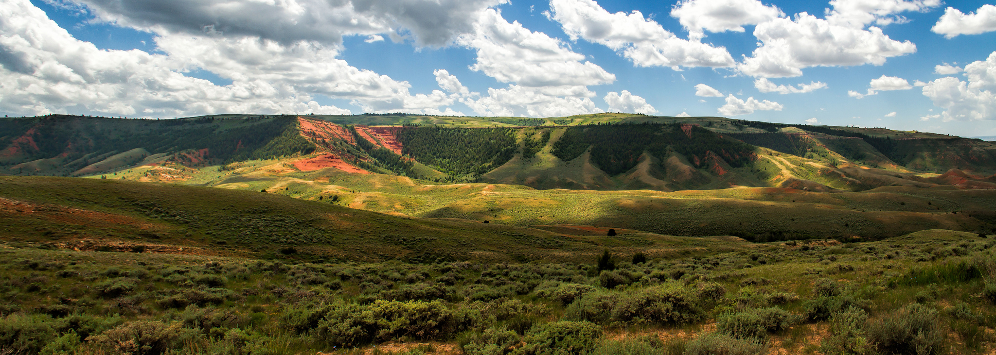
Choosing a Journal
Ask For Advice
Faculty in your department
Colleagues at other institutions
Librarians
The editor of the journal (“Would you be interested in an article on…”)
“Landscape” by Jeremy Thies CC BY-NC-ND 2.0

Slide 18
Resources
Directory of Open Access Journals (DOAJ)
https://doaj.org/
Open Access Scholarly Publishers Association
http://oaspa.org/

Slide 19
RESEARCH MISCONDUCT & PLAGIARISM

Slide 20
Research Misconduct
Research Misconduct
Per the federal regulations “Research Misconduct”
is very narrowly defined.
Specifically, Research Misconduct means fabrication,
falsification, or plagiarism in proposing, performing, or
reviewing research or in reporting research results.
(42 CFR 93.103)

Slide 21
Research Misconduct
Fabrication
“Fabrication” is making up data or results and recording or reporting them.
Examples include: Recording data for non-existent research subjects, reporting results for experiments that were not done.
NOTE - Even just writing down bogus data (e.g., in a lab notebook) is considered RM. The bad data doesn’t have to be published or released in any way for it to be a problem.

Slide 22
Research Misconduct
Falsification
“Falsification” is manipulating research materials, equipment, or processes, or changing or omitting data or results such that the research is not accurately represented in the research record.
Examples include:
The reuse of an image as representing different experimental conditions,
image manipulation (splicing, cropping, obscuring, enhancing),
changing data results for a better “fit”, etc…

Slide 23
Research Misconduct
Plagiarism
“Plagiarism” is the appropriation of the ideas, processes, results, or works of another person, without giving appropriate credit.
Examples include:
Cutting and pasting whole sections of text from another source without clearly indicating its origin.
Pulling images from the web or other sources without attribution.

Slide 24
Research Misconduct
Plagiarism
Not all ‘plagiarism’ is ‘Plagiarism’
Self-plagiarism
Information/materials generated with former collaborators is not typically considered Plagiarism but instead handled as an Authorship or credit dispute
This can often be a very gray area
How much copying is too much?
How many different ways can you describe something?

Slide 25
Research Misconduct
Plagiarism
OSU licenses the software program iThenticate for use by any OSU faculty, staff, or student.
iThenticate is an anti-plagiarism software that screens your document against a database of over 40 million published articles, webpages and other scholarly content.
iThenticate does not identify ‘Plagiarism’ but instead highlights text in your document that matches other published material to allow you to determine if text is appropriately cited.
For more information please go to http://orc.osu.edu/regulations-policies/misconduct/avoiding-plagiarism/

Slide 26
Research Misconduct
Since 1975 there has been a 10 fold increase in the number of papers retracted due to fraud.
(Fang et al., (2012) PNAS 109(42):17028-17033).
• Watchdog websites like Retraction Watch and Pub peer as well as mainstream media are actively involved in the scrutiny of research.
This is a topic of intense interest to the media and public.
• Journals and funding sponsors are actively screening submissions for plagiarized text.
• Screening software packages for looking for plagiarized text and image manipulations are now easily available.
• Rise of “Academic Warfare” and specific targeting of individuals.

Slide 27
RESPONSIBLE CONDUCT OF RESEARCH (RCR)

Slide 28
Responsible Conduct of Research
Responsible Conduct of Research (RCR)
“Responsible Conduct of Research” (RCR) is the
term used to collectively refer to the procedures, policies, guidelines, regulations, and accepted best practices that should be followed to ensure that the research is conducted legally, ethically, and with the highest scientific rigor and integrity.
‘Rigor and Reproducibility’ of research is a hot button topic right especially with the NIH and other federal sponsors. You may be asked to authenticate key biological and chemical reagents in proposals and reports. Expect these requirements to only increase.

Slide 29
Responsible Conduct of Research
Core elements of RCR include:
1. Data Management (collection, protection, storage,
ownership and sharing)
2. Conflicts of Interest and Commitment
3. Integrity of Research and Research Misconduct
4. Authorship & Acknowledgement of credit
5. Publication & Peer Review process,
6. Conducting collaborative science,
7. Training and mentoring,
8. Laboratory safety,
9. Use of humans and animals in research.

Slide 30
Data Management
Data Management
Data Management best practices cover research
records (data) activities including:
• Collection
• Sharing
• Ownership
• Retention
• Protection
• Storage
See University Research Data Policy for more information

Slide 31
Data Management
What is a “Research Record?” – any data or results
that embody the facts resulting from scholarly inquiry.
“A research record includes: grant or contract applications, progress or other reports. Laboratory notebooks, notes, correspondence, videos, photographs, x-ray film, slides, biological materials, computer files, printouts, manuscripts, publications, equipment use logs, laboratory procurement records, animal facility records, human and animal subject protocols, consent forms, medical charts, and patient research files.”
Defined in the University Policy and Procedures Concerning Research Misconduct

Slide 32
Data Management
Data Sharing
Generally speaking, the NIH expects researchers to
share data generated using public funds with the
public.
Most of the major federal sponsors now require that you include a data sharing/management plan in your proposal.
Data sharing is not an absolute requirement but if you aren’t going to share your data you will need to state why you aren’t going to share the data.
See NIH website http://grants.nih.gov/grants/policy/data_sharing/

Slide 33
Data Management
Data Management Plans
Many federal sponsors require that you file a data management plan (DMP) with your grant proposal.
OSU is part of a consortium of institutions with access to an online DMP Tool developed by the University of California.
The DMP Tool facilitates the creation of DMPs using agency specific formats and in many cases boilerplate template language is available for your use.
For instructions on accessing and using the DMP tool please go to: https://library.osu.edu/researchcommons/2015/01/19/dmptool/

Slide 34
Data Management
Data Ownership
• Who owns the data generated at the university?
• Who gets to say how it is used?
Can you take your data with you if you leave?
• What happens if there are disagreements about the use,
publication or access to the data?
See University Research Data Policy for more information on data ownership and access to research data.

Slide 35
Data Management
Data Storage/Protection/Retention
• Access – active use, long term storage, indexing, inventories
• Appropriate classification of data (public, internal, private, restricted)
Security or confidentiality requirements on data (e.g., export controls, HIPPA, FISMA)
• Retention time requirements – federal regulations, sponsor
requirements, institutional requirements
Formats – will it still be readable in 3 yrs, 10 yrs?
Will there be special equipment/software needed to access
data?
Back-ups & offsite storage

Slide 36
EXPECTATIONS FOR AUTHORSHIP

Slide 37
Authorship
Authorship & Acknowledgement
Under the University Research Data Policy, the Principal Investigator has the right and responsibility for:
the assignment of authorship and acknowledgement credit;
choosing the time and venue of publication of research data and results;
ensuring that all research is accurately reported; and
ensuring that all persons listed as authors or in acknowledgements meet the accepted criteria in their field for authorship or acknowledgement.
http://orc.osu.edu/files/ResearchDataPolicy.pdf

Slide 38
Authorship
Authorship & Acknowledgement
There are a number of societies/associations that have published guidelines regarding the assignment of authorship or acknowledgement on manuscripts.
What constitutes authorship credit can be very discipline specific.
Most (reputable) journals will publish their own specific criteria or reference out a specific guideline (e.g., COPE or ICJME) for assigning authorship or acknowledgement

Slide 39
Authorship
Authorship & Acknowledgement
International Committee of Medical Journal Editors (ICMJE): Guidelines generally accepted for use in Biomedical Journals. Authorship under ICJME generally requires:
“A substantial contribution to the conception or design of the work; or the acquisition, analysis, or interpretation of data for the work; AND
Drafting the work or revising it critically for important intellectual content; AND
Final approval of the version to be published; AND
Agreement to be accountable for all aspects of the work in ensuring that questions related to accuracy or integrity of any part of the work are appropriately investigated and resolved.”
Authors need to meet all 4 criteria, if they don’t meet all 4, then they should be acknowledged.
http://www.icmje.org/recommendations/browse/roles-and-responsibilities/defining-the-role-of-authors-and-contributors.html

Slide 40
Authorship
Authorship & Acknowledgement
Committee on Publication Ethics (COPE): A forum of journal editors and publishers who provide guidelines, flowcharts, etc., related to issues involving ethical publishing and dealing with issues of research misconduct.
COPE is geared towards answering what to do in certain situations rather than providing defined criteria for things like authorship and acknowledgement.
See COPE homepage at http://publicationethics.org/about

Slide 41
CONFLICTS OF INTEREST

Slide 42
Conflicts of Interest
Conflicts of Interest
What is a conflict of interest?
What kinds of conflicts exist?
Conflicts can be real or perceived and both are important.
A conflict of interest does not by itself mean that there is an unethical situation, it just indicates that there is the potential for a problem that needs to be managed and/or disclosed.
See University policy on Faculty Financial Conflicts of Interest

Slide 43
Conflicts of Interest
Conflicts of Interest
“Financial COI” - A financial conflict of interest exists if financial interests or other opportunities for tangible personal benefit may exert a substantial and improper influence on a person’s professional judgment in exercising any
duty or responsibility, including designing, conducting, or
reporting research.
Examples of common financial interests include: any income,, consulting, equity interests, stock ownership, stock options, honoraria, intellectual property/patents/royalties, paid authorship, or paid expert testimony

Slide 44
Conflicts of Interest
Conflicts of Interest
Other types of conflicts of interest to be aware of that can impact the peer review/publishing process include:
Personal relationships (both good and bad)
Professional relationships and academic hierarchies
Academic rivalries, Corporate rivalries
Philosophical or intellectual differences
The best course of action is to always be as transparent as possible and disclose to the journal or other interested parties any activity that could be viewed as a potential conflict of interest.

Slide 45
CONFLICTS OF COMMITMENT

Slide 46
Conflicts of Commitment
Conflicts of Commitment
Per the university’s conflicts of commitment policy, faculty are required to avoid any conflicts of commitment when carrying out their university responsibilities, including their education, research, scholarship or service responsibilities.
Specifically, “a conflict of commitment exists when external or other activities are so substantial or demanding as to interfere with the individual’s teaching, research, scholarship or service responsibilities to the university or its students.”
See University Conflict of Commitment Policy for more information.

Slide 47
QUESTIONS?
Melanie Schlosser
Digital Publishing Librarian
Publishing and Repository Services
University Libraries
schlosser.40@osu.edu
Jen Yucel
Director and Research Integrity Officer
Office of Research Compliance
yucel.4@osu.edu

