Slide 1

ECE 3567 Microcontroller Lab
Lecture #3 – Code Composer Studio
Spring 2025
Dr. Gregg Chapman

Slide 2
Project Set-up
Before doing ANYTHING, make a folder on the U: Drive that will be your Workspace.
You may create more than one project in the same workspace.
I recommend having a separate workspace for each lab. Code Composer creates the PROJECT folder. You define the WORKSPACE.
NEVER have more than one project in a project folder!!!!

Slide 3
Project Set-up
Invoke the Code Composer Studio version 10.1.0 software by double clicking on the CCS ICON

Slide 4
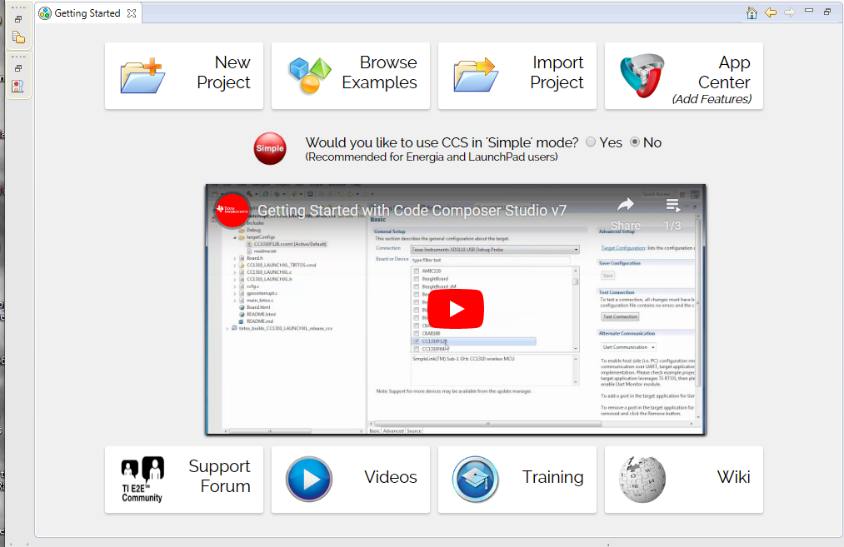
Project Set-up
If you are beginning with the Getting Started screen, select New Project:
If only Project Explorer is open, select View → Getting Started

Slide 5
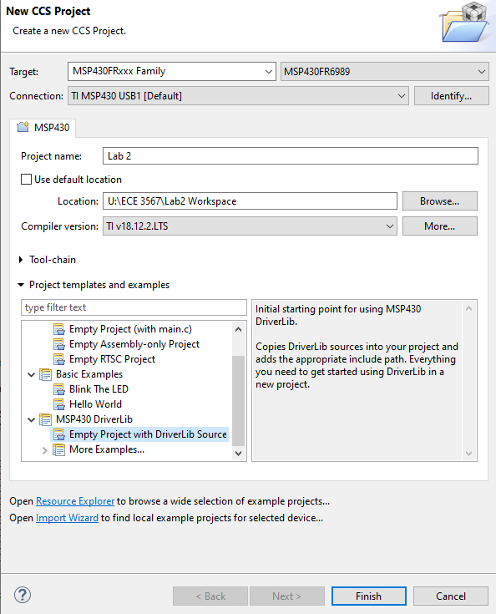
Project Set-up
In the CCS Project window, configure the following fields:
  Target: MSP430FRxxx Family
  MSP430FR6989
  Connection: Leave at Default
  Project Name (e.g. Lab 2)
  Uncheck use default location and browse to YOUR WORKSPACE
  (e.g. U:\ECE3567 OR U:\ECE3567\Lab2 Workspace)
  This depends on how you set it up. CCS will create a project folder with the Project Name under the WORKSPACE you define in LOCATION.
  Leave Compiler at Default
  In Project templates and examples, you must SCROLL DOWN
  to MSP430 Driverlib, select the down arrow ∨ and
  SCROLL DOWN AGAIN. Highlight:
  Empty Project with DriverLib Source
  Select Finish

Slide 6
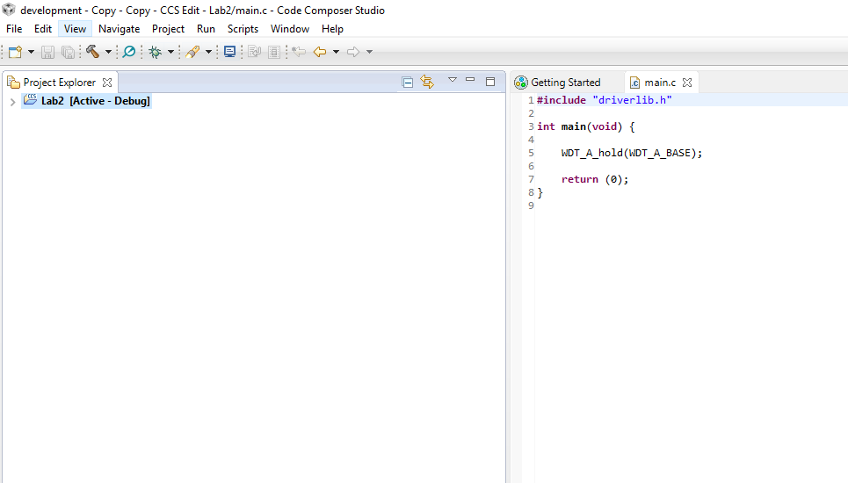
Project Set-up
"Voilà"

Slide 7
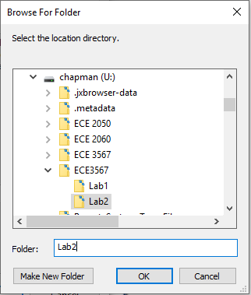
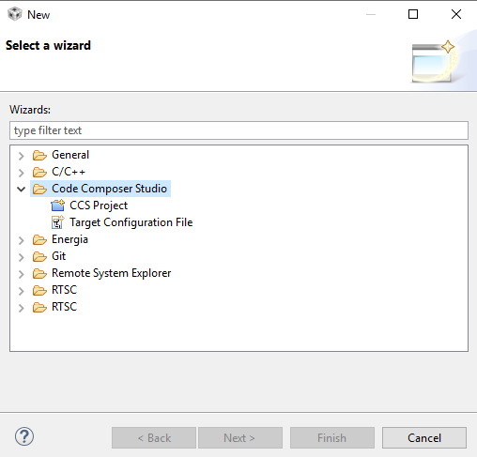
Project Set-up
ALTERNATIVELY: If you are beginning with another project already open in Project Explorer:
1. Select File → Switch Workspace and navigate to your new workspace
2. Select File → New → Project → Code Composer Studio → CCS Project

Slide 8
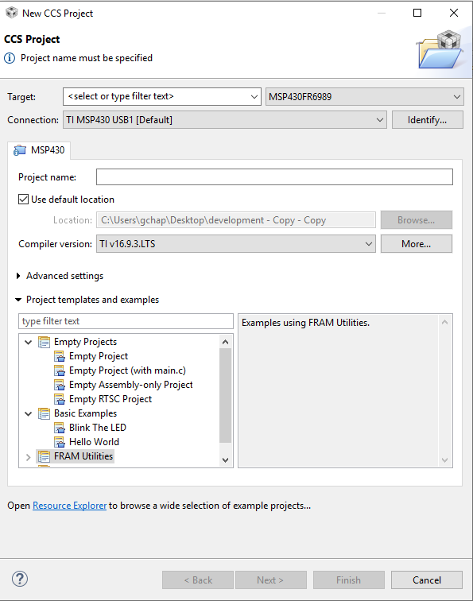
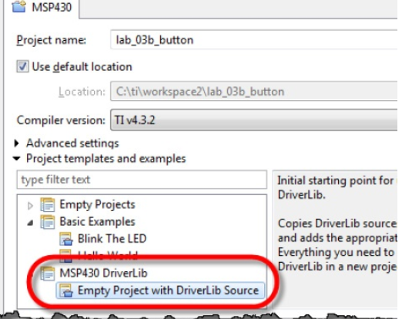
Project Set-up
3. This should open the New CSS Project window. Proceed as previously described.
Don’t Forget to select this template.

Slide 9
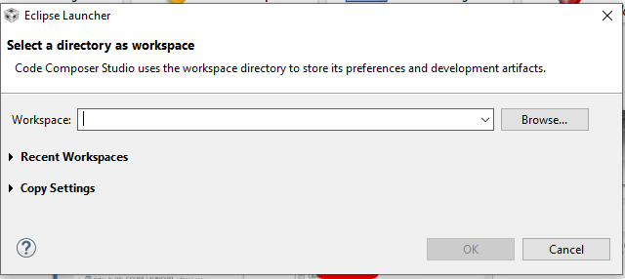
Project Set-up
The FIRST time you use the workspace, CCS MAY open the Eclipse Launcher.
Browse to the workspace that you have created, then select OK

Slide 10
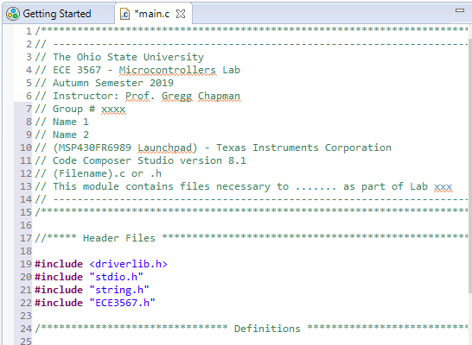
Code Composer Studio – Adding Code
Select File → New → Source File
Enter Code
Save the File
Select Project → Rebuild Project
You may also COPY files into your project folder then add them to the project with a Right-Click on your Project Name [Active-Debug] . Then select Add Files . . .
NOTE: It’s better to copy in the standard file header and edit it than starting with the default main.c
DON’T LOSE POINTS!

Slide 11
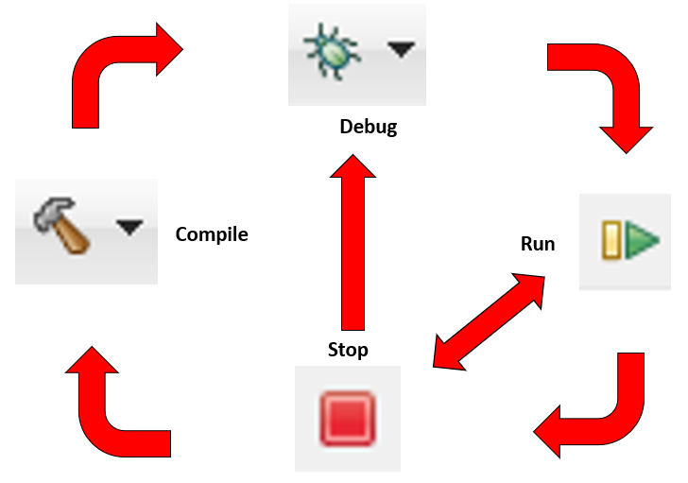
Code Composer Studio – Running the Project Code
At this point it is essential to connect the hardware
Make sure that the Project is selected as [Active – Debug]
You can check to see if the code compiles by selecting the hammer ICON
Select the Debug ICON (NOTE: This will also recompile the project)
Once the GREEN ARROW comes up you can run the code
Halt execution with the RED SQUARE

Slide 12

Code Composer Studio – To Open an Existing Project
(Automatic Method)
This doesn’t always work
Make sure that the Workspace is set to your project location. To change it, select File → Switch Workspace, and navigate to the project location
Double-click the .ccsproject ICON in the project folder
If it doesn’t work, try the Manual Method

Slide 13
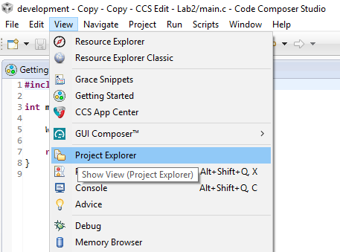
Code Composer Studio – To Open an Existing Project
(Manual Method)
If your project does not appear
Select View → Project Explorer

Slide 14
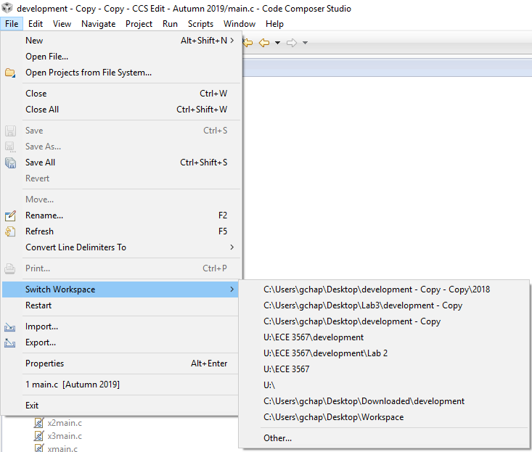
Code Composer Studio – To Open an Existing Project
(Manual Method)
If you still don’t see anything in Project Explorer
Select File → Switch Workspace, and navigate to the project location

Slide 15
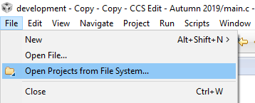
Code Composer Studio – To Open an Existing Project
If you STILL don’t see your project in Project Explorer, re-open the file:
File → Open Project Files from File System . . .

Slide 16
Transferring a Project to a New Location
If you move the location of your CCS project files , you must do two things before your project will function normally:
Change the Workspace
Update the path for the Include Options paths under the Complier settings if they are not correct.

Slide 17
Change Workspace
Select File → Switch Workspace → Other
Enter the new workspace. Always select the file ABOVE your Project file that CCS created. This is usually your current Workspace folder.
When you select OK, Code Composer will restart

Slide 18
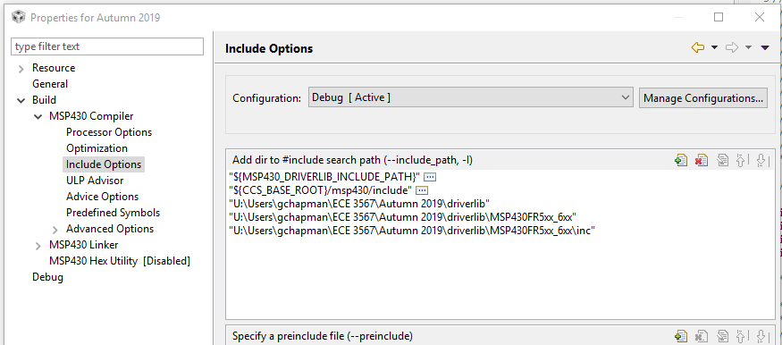
Change Include Options
Right Click on your Project Name [Active-Debug] . Select Properties (all the way at the bottom of menu)
Go to Include Options under MSP430 Compiler
You will need to add the proper path to all three of the following :
    “U:\<your path>\<your project name.\driverlib“
    “U:\<your path>\<your project name.\driverlib\MSP430FR5xx_6xx“
    “U:\<your path>\<your project name.\driverlib\MSP430FR5xx_6xx\inc“
    NOTE: DON’T copy my path format, this is on my computer at home.
Use the ICON to add path
Delete old paths to same
folders using ICON
When finished, click OK

Slide 19
Code Composer Studio
Common Error Messages
ERROR: Unable to Launch. The selection cannot be launched, and there are no recent launches
Solution: Switch Workspace : File => Switch Workspace => Other
Always select the folder that is ONE LEVEL ABOVE your project folder as the workspace.
REBUILD PROJECT.
ERROR: Cannot open source file “driverlib.h” (You may not have selected ‘Empty Project with Driverlib Source’ when you set up the project!)
Solution: MANUALLY change the paths to the following folders -
1. Right click the project set as [Active-Debug] and open Properties
2. Under MSP430 Compiler options, select Include Options
3. Delete old paths to driverlib
Add ALL THREE new paths:
…/ driverlib
…/ driverlib/MSP430FR5xx_6xx
…/ driverlib/MSP430FR5xx_6xx/inc

Slide 20
Code Composer Studio - Watch Window
Note that, unlike the TI C2000 series (ECE 2050). there is not a dynamic debugger for the TI MSP430 LaunchPads. Expressions and Variables are only updated after a Breakpoint is reached, and NOT available if the Debugger is halted.
Select View → Expressions
Right click to add registers or variable names.
Set breakpoints
Run the Debugger

Slide 21
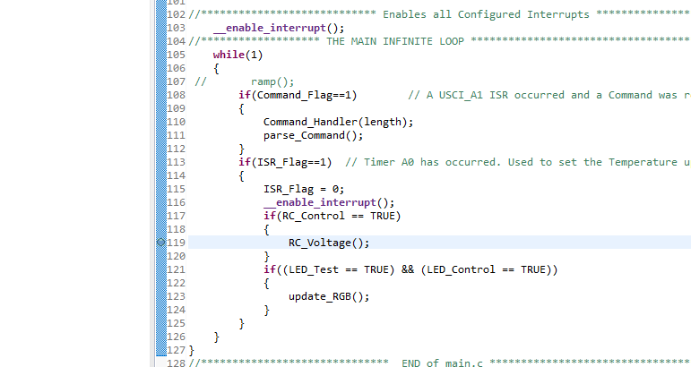
Troubleshooting - Breakpoints
Double click the line number to set a breakpoint
You must re-compile to incorporate the breakpoint
Click twice more to clear a breakpoint
Note: The debugger cannot always set a breakpoint on a selected line. If you get a compiler error, select another line of code.

Slide 22
Serial Communications via UARTs
Setting up the Terminal Window
(for Lab 5 – Serial Communications)

Slide 23
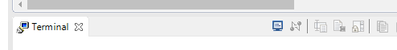
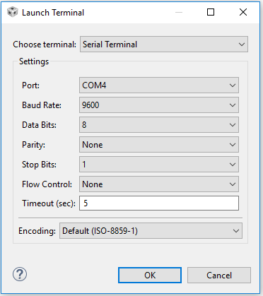
Code Composer Studio – The Terminal Window
View → Terminal
Click on the ICON to launch the terminal. The Launch Terminal window should open:
Choose the Serial Terminal to switch to the proper settings
The pulldown menu for Port should list the available COM ports. If these end up not working, you will have to resort to the process on the following slide to discover the COM ports
If not already the default settings, select: Baud Rate – 9600, Data Bits – 8, Parity – None, Stop Bits – 1,
Flow Control – None, Timeout – 5 secs,
Encoding - Default (ISO-8859-1)
Select OK

Slide 24
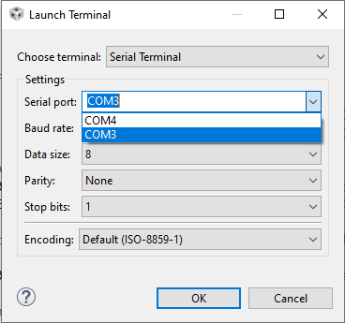
Finding an Available COM Port
The list of available COM ports should update in the CCS Terminal menus.

Slide 25
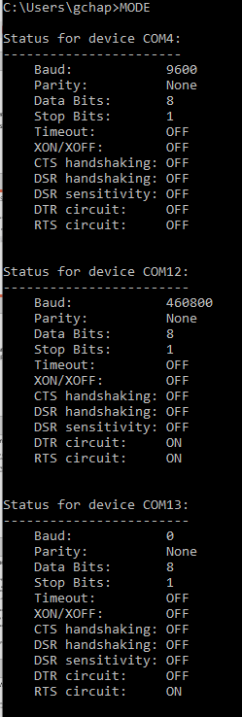
Finding an Available COM Port
If the list of COM ports is not available in CCS, you can look at available COM ports in the Command window. This procedure should only be necessary if you suspect CCS is not updating the list.
Each lab computer uses numerous COM ports. To identify:
type CMD in the search window to bring up the Command Line Prompt
type MODE and write down the communication port numbers that are available
(e.g. COM4, COM12, COM13). The first listed is usually already in use.
Close the Command window
NOTE: COM port numbers are DYNAMIC. When you unplug your LaunchPad and plug it back in, the COM port numbers WILL be different. Check the Terminal list of COM ports, or run the CMD/MODE again to document the NEW list of available COM ports.

Slide 26
Communication
When you run the ECE 3567 Project program in Lab 5, You should receive the following message from the ECE 3567 software:
ECE 3567 Microcontroller Lab
Please enter a Command Code:
You can test the transmit with any valid two-character command, which must be capitalized. If they are not programmed, you will receive:
UNKNOWN COMMAND
Please enter the next Command Code:
You will add this functionality to the code in Lab 5

Slide 27
Introduction to Lab 1

Slide 28
Lab 1 – Blinking LEDs
Goals:
1) Learn to set-up a new Project in Code Composer Studio
2) Learn to code, compile and run a project in Code Composer Studio
3) Gain experience with the Bitwise C operators to control external hardware.
4) Learn how to re-configure your project when the code is moved to a different path.

Slide 29
Lab 1 – Blinking LEDs
Write a program that will illuminate the red and green LEDs on the MSP430FR6989 Launchpad board.
Which LED is illuminated should alternate at approximately one second intervals.
For this lab, we will not use timers or interrupts. Write delay code in the main loop and manipulate the proper output pins to the LEDs using generalized I/O ports 1 and 9 (see schematic).
We will not use TI macros to control the I/O ports in this lab.
Once your project is working. You will be asked to change the location of your code and make the necessary changes to get the code running again
You will NOT be prepared to write the Lab 1 code or pass the quiz if you do not watch and understand the Lab 1 Video.

Slide 30
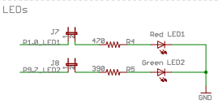
Lab 1 - Schematic
P1.0
P9.7
Jumpers are installed

