Slide 1
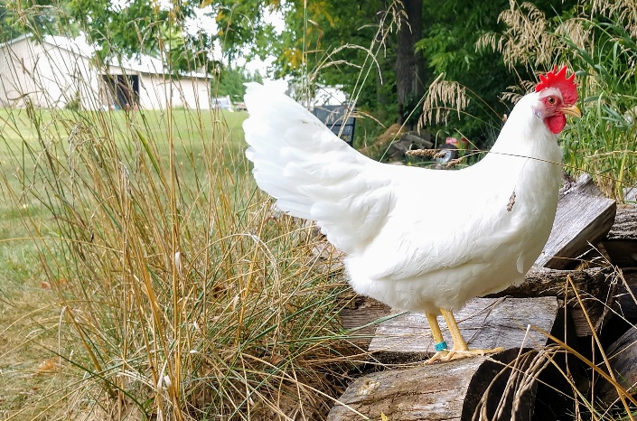
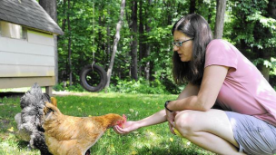
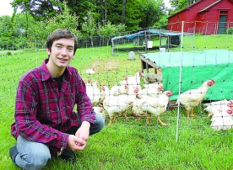
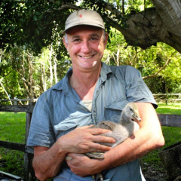
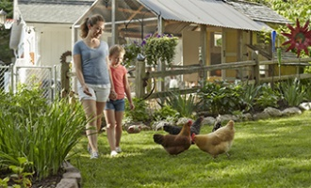





Veterinary Extension
I think my birds have the flu. What do I do?
Veterinary Extension
Poultry Owners
If your birds are dying at an alarming rate, you should immediately contact any of the following:
Ohio Department of Agriculture
Animal Disease Diagnostic Laboratory: (614) 728-6220
After Hours: (888) 456-3405.
US Department of Agriculture
Toll-free number
(866)-536-7593
Ohio Poultry Association
info@ohiopoultry.org
Phone: (614) 882-6111
If your birds are suspected of having influenza, they will be tested by ADDL
Bird Flu
What is it?
How to avoid it?
Bird flu, or avian influenza, is a disease caused by influenza type A virus that can infect poultry. Most strains are low pathogenic. Highly pathogenic strains (HPAI) are highly contagious in birds and often cause death in poultry.
The United States aims to remain free from Highly Pathogenic Avian Influenza (bird flu). This means that the preferred course of action in the event of an outbreak is to immediately eradicate the disease.
Poultry Owners need to be on alert and protect their birds through proper biosecurity. Owners and their flocks must avoid any direct or indirect contact with wild birds or other poultry. If there is high mortality, owners should submit birds to be tested.
Q: Is this a new bird disease?
A: There are many different subtypes and strains of flu viruses that circulate, and can evolve into new strains. Those designated as HPAI can be devastating to poultry.
Q: Is it the same as the human influenza?
A: This particular version of the virus does not infect humans. It is strictly a bird disease, not a threat to human health as stated by CDC. Eggs, chicken and turkey are safe to eat.
This project was supported by Agriculture and Food Research Initiative Competitive Grant no. (2015-68004-23131) from the USDA National Institute of Food and Agriculture.
Any opinions, findings, conclusions, or recommendations expressed in this publication are those of the author(s) and do not necessarily reflect the view of the U.S. Department of Agriculture.

Slide 2
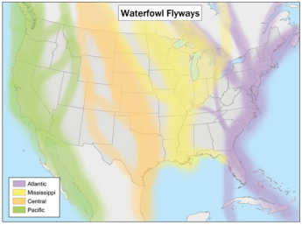
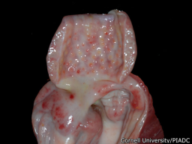
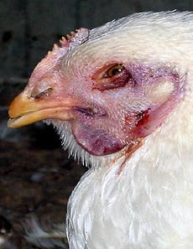
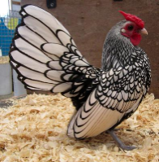
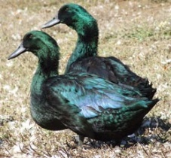
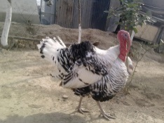
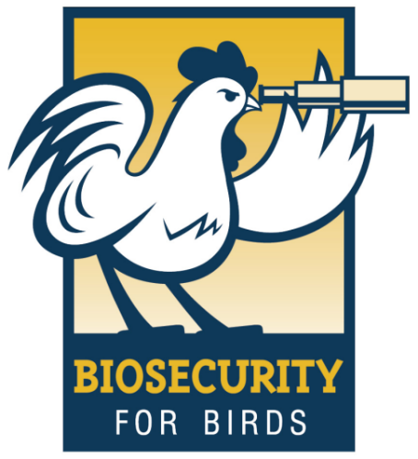
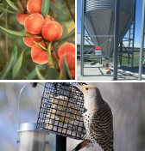
HPAI: Improve Biosecurity with Wildlife Deterrents
Q: How will I know if my birds get infected with this virus?
One of the earliest signs of the disease is increased death with up to 100% mortality in many cases.
Birds will also show signs of sickness, twisted necks, blue and swollen faces and feet. The most consistent necropsy lesion was hemorrhages on the proventriculus (See pictures below).
Wild migratory waterfowl are thought to be the source of the disease. The state of Ohio is part of the Mississippi Flyway.
Certain diseases, including Avian Influenza, have little to no illness in wild waterfowl yet can have a huge impact in your domestic flock.
Strengthen your farm biosecurity by implementing wildlife management practices to limit exposure to your flock.
:Remove standing water. Even shallow water can attract wildlife. Make sure to keep your birds away from this area. Do not walk or move equipment near areas visited by wild waterfowl.
Do not use pond water as drinking water. Only provide clean filtered water to your birds.
Reduce wildlife feed sources. Do not feed wildlife and have poultry feed in secured area.
Add wildlife deterrents. Use decoys such as swans or predators and move frequently to improve effectiveness. Add fencing around ponds.
Q: Can this disease affect my backyard/show flock or 4-H project?
Yes, Avian influenza can infect all domestic poultry including chickens, turkeys, and ducks. It is important to have good biosecurity practices in place and keep your birds away from wild waterfowl.
Q: How can I protect my birds from this terrible disease?
BIOSECURITY
Biosecurity includes all of the sanitary practices that are implemented to prevent the spread of diseases. These include:
  Prevent any contact with wild birds
  Prevent any contact with other animals, wild or domestic
  Keep your birds sheltered in animal proof/ bird proof houses
  Avoid visitors to your flock
  Use disposable gloves and shoe covers before you come in contact with your birds or their environment
  Wash your hands before and after contact with your birds or their environment
  Use dedicated cloths to work with your birds, or use disposable coveralls
  Avoid using surface water (ponds or lakes) as a source of drinking water for your birds
  Acquire your feed from reliable sources and store it in a clean, dry, and cool place away from wild birds or wild animal’s access, particularly rodents
  USDA provides excellent resources for bird biosecurity at: USDA’s Defend The Flock Program
Notes:
Prevent any contact with animal, wild or domestic.
Keep your birds sheltered in animal proof/ bird proof houses.
Avoid visitors to your flock
Use disposable gloves and shoe covers before you come in contact with your birds or their environment
Wash your hands before and after becoming in contact with your birds or their environment
Use dedicated cloths to work with your birds, or use disposable coveralls.
Avoid using surface water (ponds or lakes) as a source of drinking water for your birds
Always use clean and disinfected water for birds’ drinking water
Acquire your feed from reliable source and store it in clean, dry and cool place away from wild birds or wild animal’s access, particularly rodents.

